Slide 1
MATHEMATICAL FOUNDATION FOR COMPUTER SCIENCE
Prepared by: Er. Ankit Kharel
Nepal college of information technology

Slide 2
Recurrence relations
Solution of Linear non-Homogeneous Recursive Relation

Slide 3
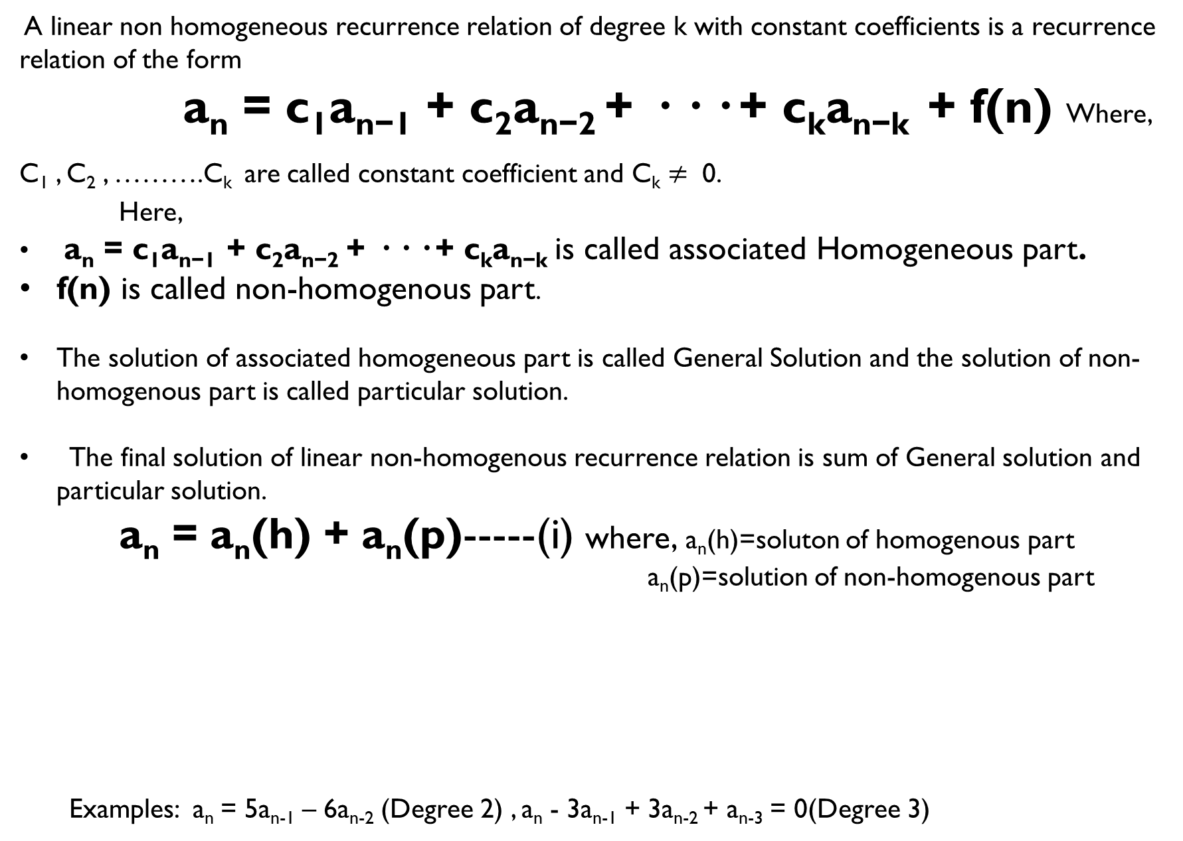
Linear homogeneous recurrence relation:
A linear non homogeneous recurrence relation of degree k with constant coefficients is a recurrence relation of the form
a_{n} = c₁a_{n−1} + c₂a_{n−2} + · · · + c_{k}a_{n−k} + f(n) Where,
C₁ , C₂ , ……….C_{k} are called constant coefficient and C_{k} $≠$ 0.
Here,
a_{n} = c₁a_{n−1} + c₂a_{n−2} + · · · + c_{k}a_{n−k} is called associated Homogeneous part.
f(n) is called non-homogenous part.
The solution of associated homogeneous part is called General Solution and the solution of non-homogenous part is called particular solution.
The final solution of linear non-homogenous recurrence relation is sum of General solution and particular solution.
a_{n} = a_{n}(h) + a_{n}(p)-----(i) where, a_{n}(h)=soluton of homogenous part
a_{n}(p)=solution of non-homogenous part
Examples: a_{n} = 5a_{n-1} – 6a_{n-2} (Degree 2) , a_{n} - 3a_{n-1} + 3a_{n-2} + a_{n-3} = 0(Degree 3)

Slide 4
Method to find Particular solution:
When f(n) = b^{n} and b is not the root of the characteristic equation
a_{n}(p) = Ab^{n}
2) When f(n) = b^{n} and b is root of the characteristic equation with multiplicity m
a_{n}(p) = An^{m}b^{n}

Slide 5
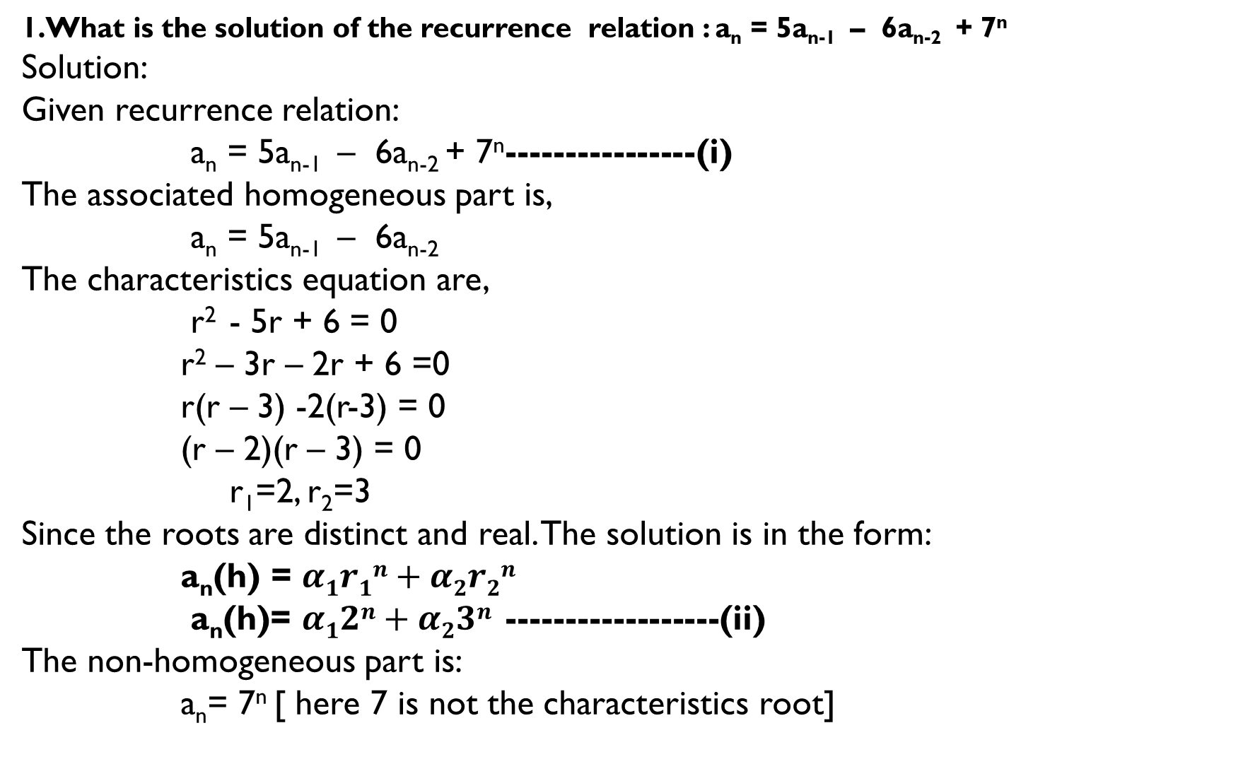
1.What is the solution of the recurrence relation : a_{n} = 5a_{n-1} – 6a_{n-2} + 7^{n}
Solution:
Given recurrence relation:
a_{n} = 5a_{n-1} – 6a_{n-2} + 7^{n}----------------(i)
The associated homogeneous part is,
a_{n} = 5a_{n-1} – 6a_{n-2}
The characteristics equation are,
r² - 5r + 6 = 0
r² – 3r – 2r + 6 =0
r(r – 3) -2(r-3) = 0
(r – 2)(r – 3) = 0
r₁=2, r₂=3
Since the roots are distinct and real. The solution is in the form:
a_{n}(h) = $α1r1n+α2r2n$
a_{n}(h)= $α12n+α23n$ ------------------(ii)
The non-homogeneous part is:
a_{n}= 7^{n} [ here 7 is not the characteristics root]

Slide 6
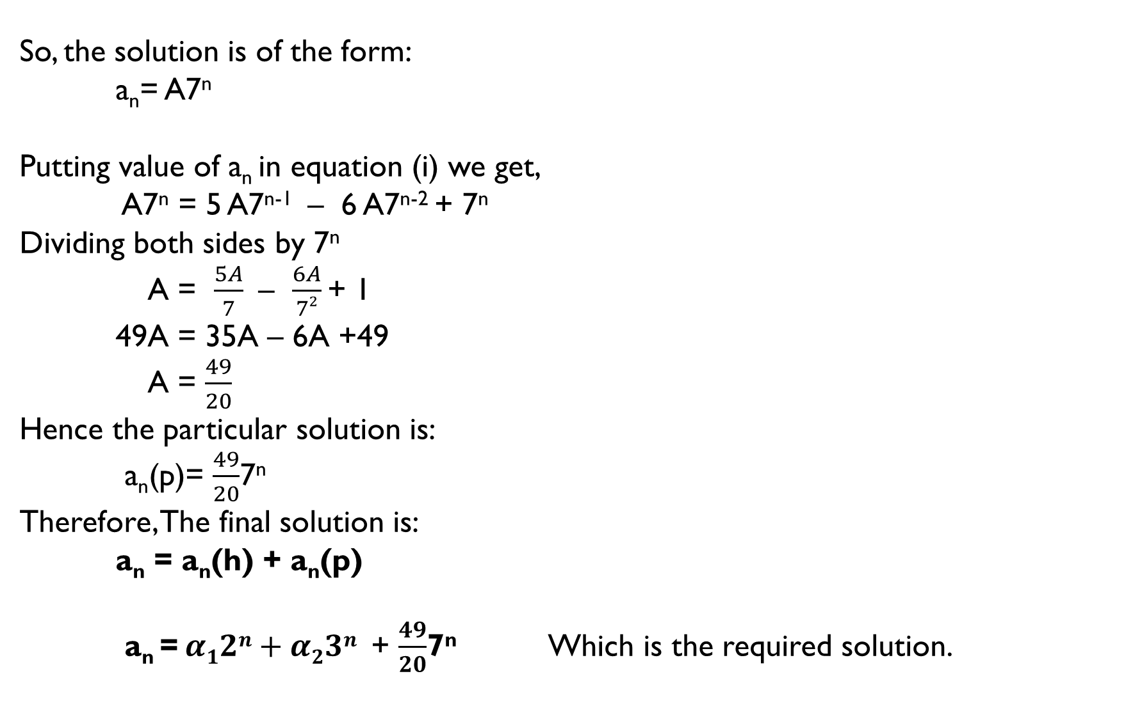
So, the solution is of the form:
a_{n}= A7^{n}
Putting value of a_{n} in equation (i) we get,
A7^{n} = 5 A7^{n-1} – 6 A7^{n-2} + 7^{n}
Dividing both sides by 7^{n}
A = $\frac{5A}{7}$ – $\frac{6A}{72}$ + 1
49A = 35A – 6A +49
A = $\frac{49}{20}$
Hence the particular solution is:
a_{n}(p)= $\frac{49}{20}$7^{n}
Therefore, The final solution is:
a_{n} = a_{n}(h) + a_{n}(p)
a_{n} = $α12n+α23n$ + $\frac{49}{20}$7^{n} Which is the required solution.

Slide 7
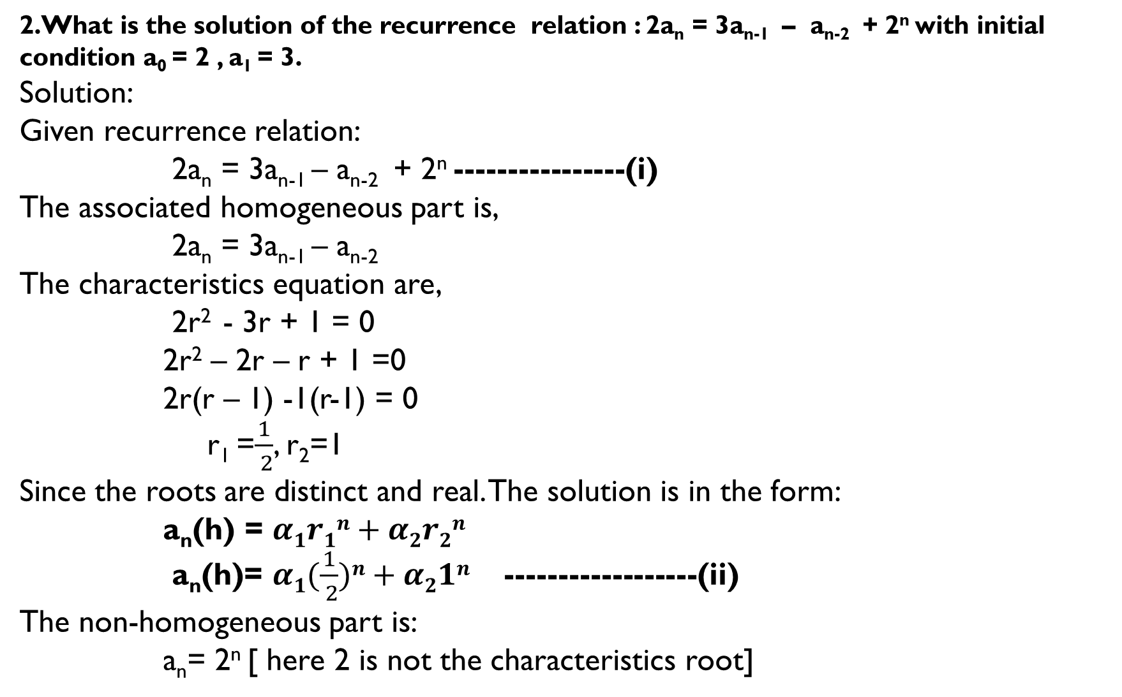
2.What is the solution of the recurrence relation : 2a_{n} = 3a_{n-1} – a_{n-2} + 2^{n} with initial condition a₀ = 2 , a₁ = 3.
Solution:
Given recurrence relation:
2a_{n} = 3a_{n-1} – a_{n-2} + 2^{n} ----------------(i)
The associated homogeneous part is,
2a_{n} = 3a_{n-1} – a_{n-2}
The characteristics equation are,
2r² - 3r + 1 = 0
2r² – 2r – r + 1 =0
2r(r – 1) -1(r-1) = 0
r₁ =$\frac{1}{ 2}$, r₂=1
Since the roots are distinct and real. The solution is in the form:
a_{n}(h) = $α1r1n+α2r2n$
a_{n}(h)= $α1(\frac{1}{ 2})n+α21n$ ------------------(ii)
The non-homogeneous part is:
a_{n}= 2^{n} [ here 2 is not the characteristics root]

Slide 8
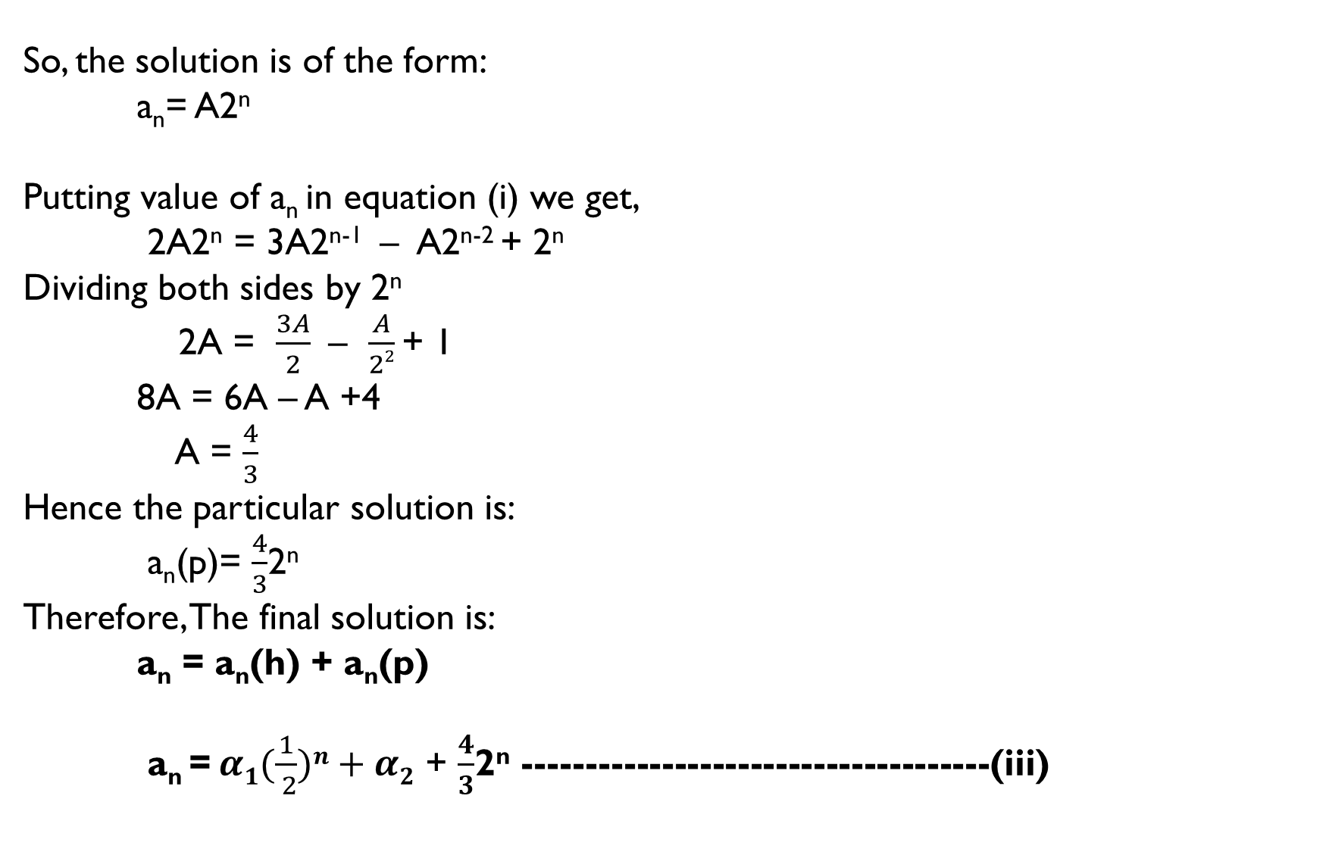
So, the solution is of the form:
a_{n}= A2^{n}
Putting value of a_{n} in equation (i) we get,
2A2^{n} = 3A2^{n-1} – A2^{n-2} + 2^{n}
Dividing both sides by 2^{n}
2A = $\frac{3A}{2}$ – $\frac{A}{22}$ + 1
8A = 6A – A +4
A = $\frac{4}{3}$
Hence the particular solution is:
a_{n}(p)= $\frac{4}{3}$2^{n}
Therefore, The final solution is:
a_{n} = a_{n}(h) + a_{n}(p)
a_{n} = $α1(\frac{1}{ 2})n+α2$ + $\frac{4}{3}$2^{n} -------------------------------------(iii)

Slide 9
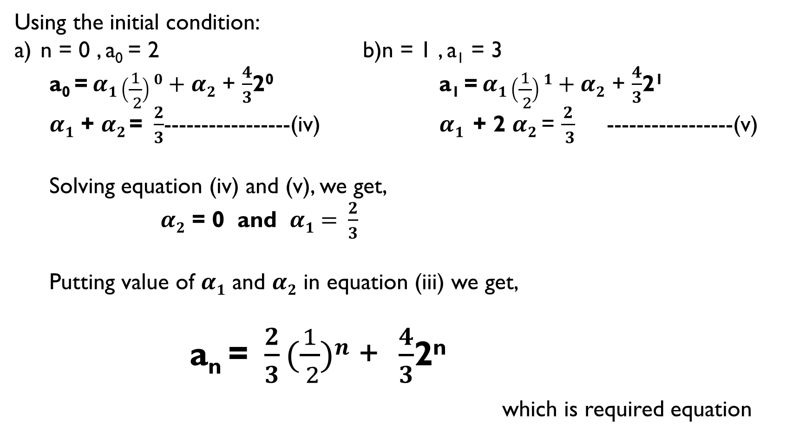
Using the initial condition:
n = 0 , a₀ = 2 b)n = 1 , a₁ = 3
a₀ = $α1\left(\frac{1}{ 2}\right)0+α2$ + $\frac{4}{3}$2⁰ a₁ = $α1\left(\frac{1}{ 2}\right)1+α2$ + $\frac{4}{3}$2¹
$α1$ + $α2$= $\frac{2}{3}$-----------------(iv) $α1$ + 2 $α2$ = $\frac{2}{ 3}$ -----------------(v)
Solving equation (iv) and (v), we get,
$α2$ = 0 and $α1= \frac{2}{3}$
Putting value of $α1$ and $α2$ in equation (iii) we get,
a_{n} =$\frac{2}{3}(\frac{1}{ 2})n$ + $\frac{4}{3}$2^{n}
which is required equation

Slide 10
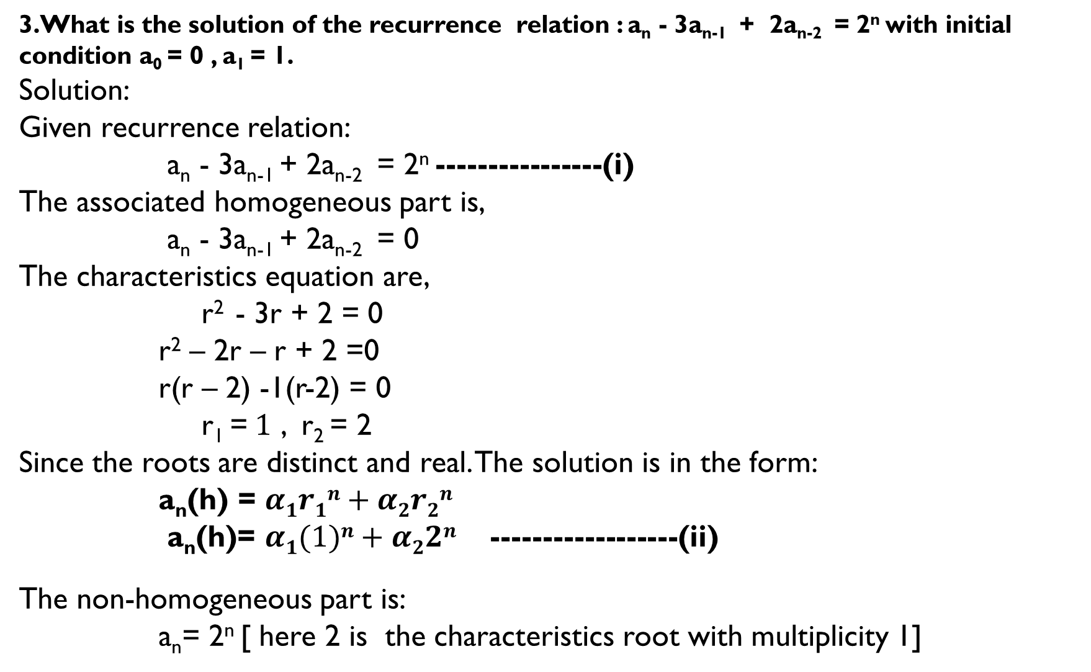
3.What is the solution of the recurrence relation : a_{n} - 3a_{n-1} + 2a_{n-2} = 2^{n} with initial condition a₀ = 0 , a₁ = 1.
Solution:
Given recurrence relation:
a_{n} - 3a_{n-1} + 2a_{n-2} = 2^{n} ----------------(i)
The associated homogeneous part is,
a_{n} - 3a_{n-1} + 2a_{n-2} = 0
The characteristics equation are,
r² - 3r + 2 = 0
r² – 2r – r + 2 =0
r(r – 2) -1(r-2) = 0
r₁ =$1$ , r₂ = 2
Since the roots are distinct and real. The solution is in the form:
a_{n}(h) = $α1r1n+α2r2n$
a_{n}(h)= $α1(1)n+α22n$ ------------------(ii)
The non-homogeneous part is:
a_{n}= 2^{n} [ here 2 is the characteristics root with multiplicity 1]

Slide 11
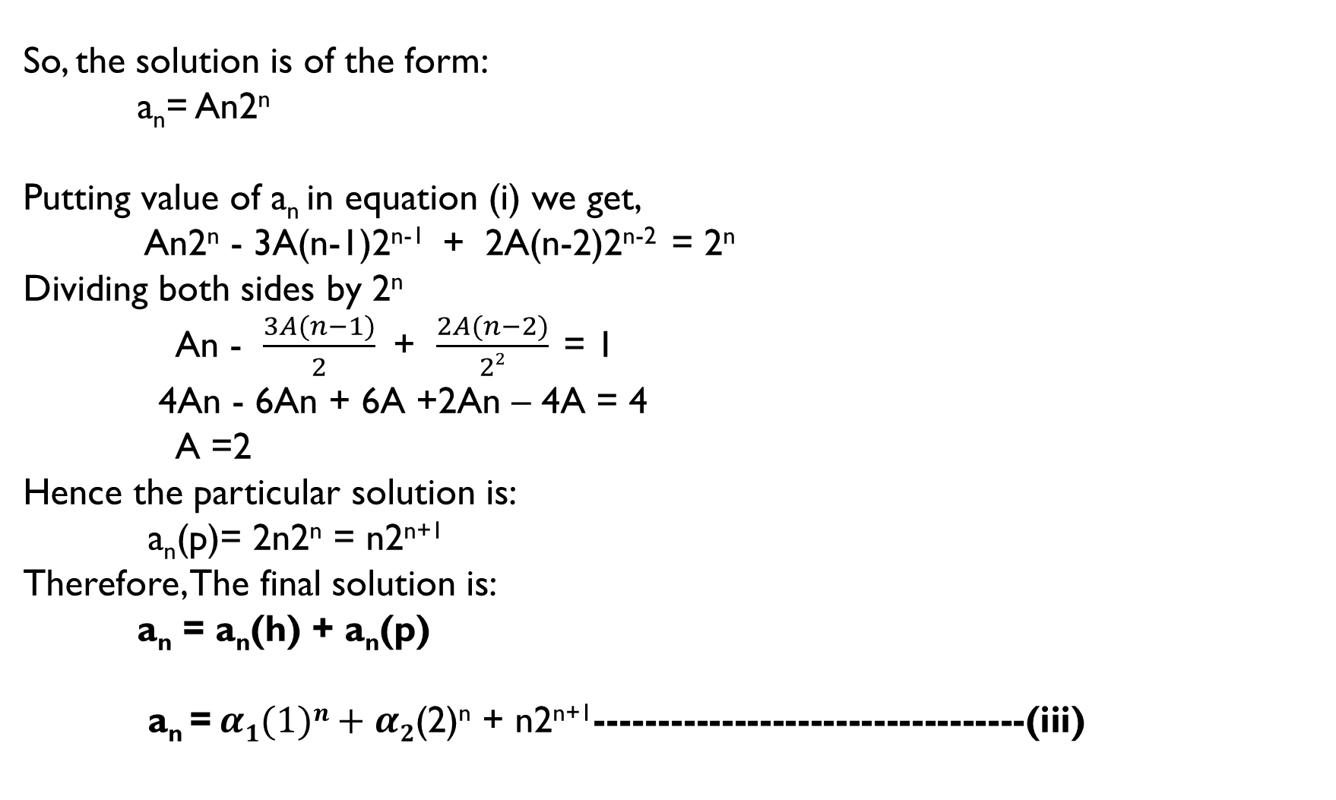
So, the solution is of the form:
a_{n}= An2^{n}
Putting value of a_{n} in equation (i) we get,
An2^{n} - 3A(n-1)2^{n-1} + 2A(n-2)2^{n-2} = 2^{n}
Dividing both sides by 2^{n}
An - $\frac{3A(n−1)}{2}$ + $\frac{2A(n−2)}{22}$ = 1
4An - 6An + 6A +2An – 4A = 4
A =2
Hence the particular solution is:
a_{n}(p)= 2n2^{n} = n2^{n+1}
Therefore, The final solution is:
a_{n} = a_{n}(h) + a_{n}(p)
a_{n} = $α1(1)n+α2$(2)^{n} + n2^{n+1}----------------------------------(iii)

Slide 12
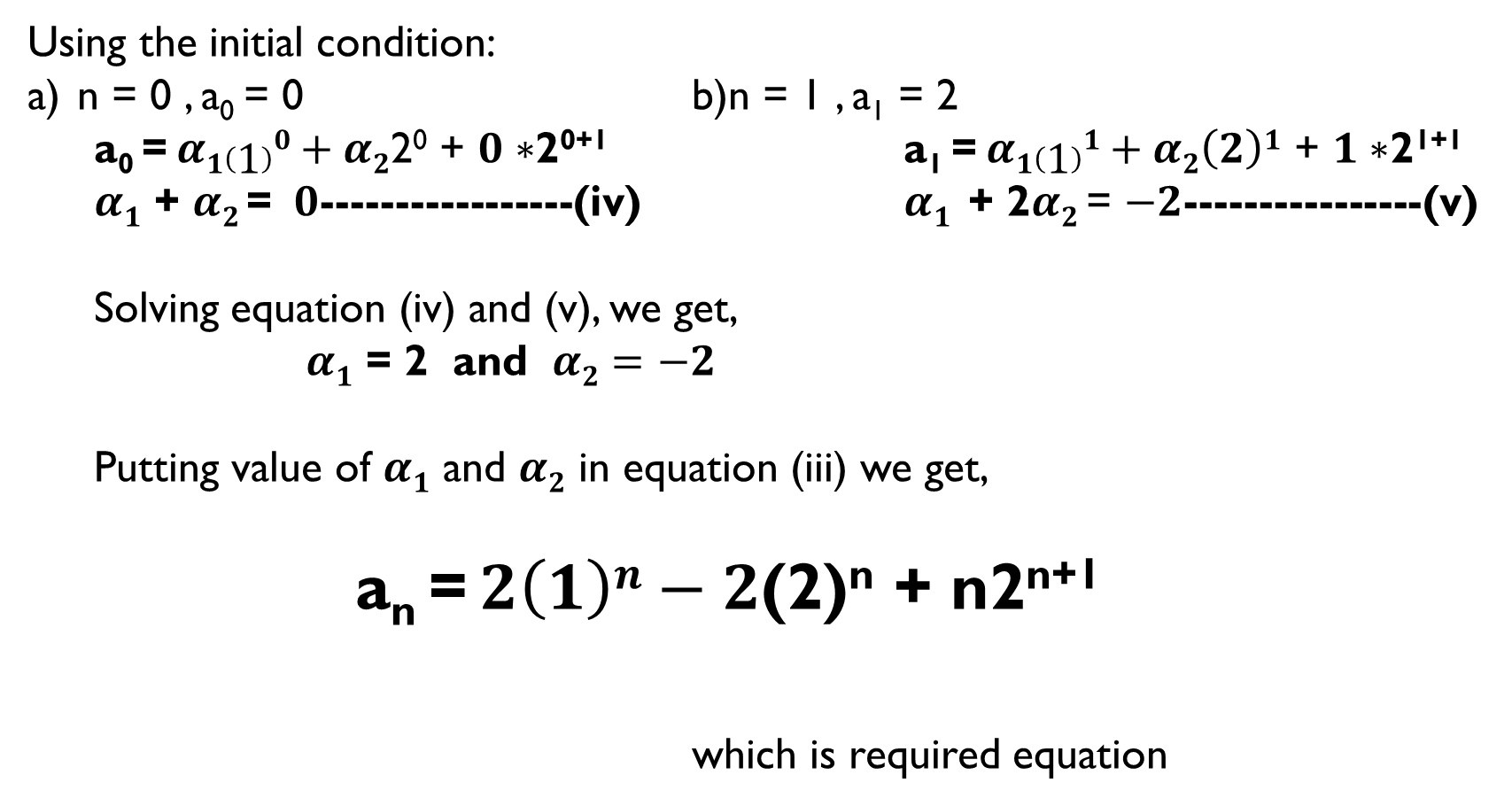
Using the initial condition:
n = 0 , a₀ = 0 b)n = 1 , a₁ = 2
a₀ = $α1\left(1\right)0+α2$2⁰ + $0∗$2⁰⁺¹ a₁ = $α1\left(1\right)1+α2\left(2\right)1$ + $1∗$2¹⁺¹
$α1$ + $α2$= $0$-----------------(iv) $α1$ + 2$α2$ = $−2$----------------(v)
Solving equation (iv) and (v), we get,
$α1$ = 2 and $α2=−2$
Putting value of $α1$ and $α2$ in equation (iii) we get,
a_{n} = $2\left(1\right)n−2$(2)^{n} + n2^{n+1}
which is required equation

Slide 13
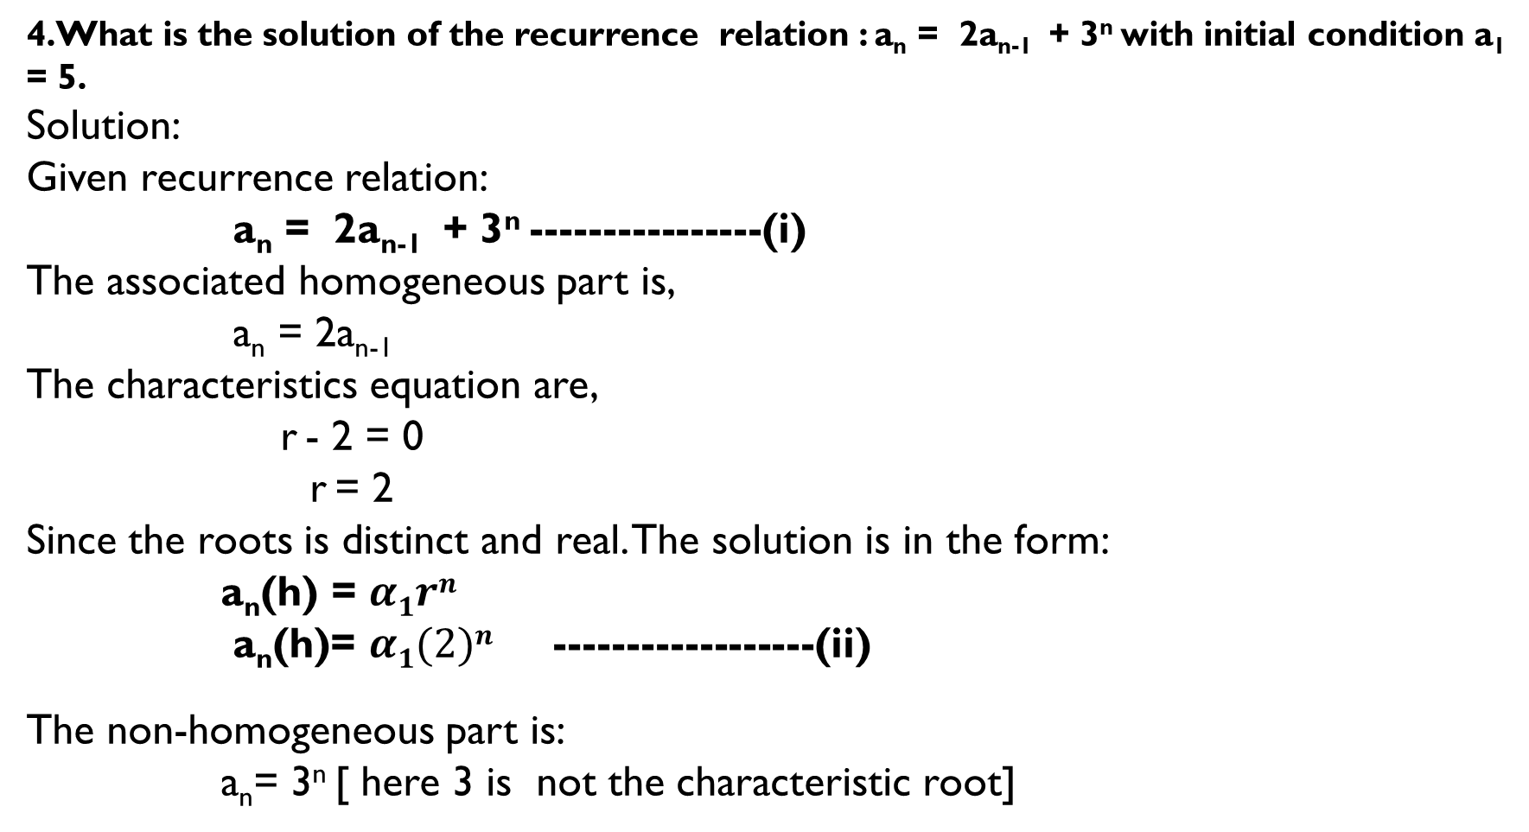
4.What is the solution of the recurrence relation : a_{n} = 2a_{n-1} + 3^{n} with initial condition a₁ = 5.
Solution:
Given recurrence relation:
a_{n} = 2a_{n-1} + 3^{n} ----------------(i)
The associated homogeneous part is,
a_{n} = 2a_{n-1}
The characteristics equation are,
r - 2 = 0
r = 2
Since the roots is distinct and real. The solution is in the form:
a_{n}(h) = $α1rn$
a_{n}(h)= $α1(2)n$ ------------------(ii)
The non-homogeneous part is:
a_{n}= 3^{n} [ here 3 is not the characteristic root]

Slide 14
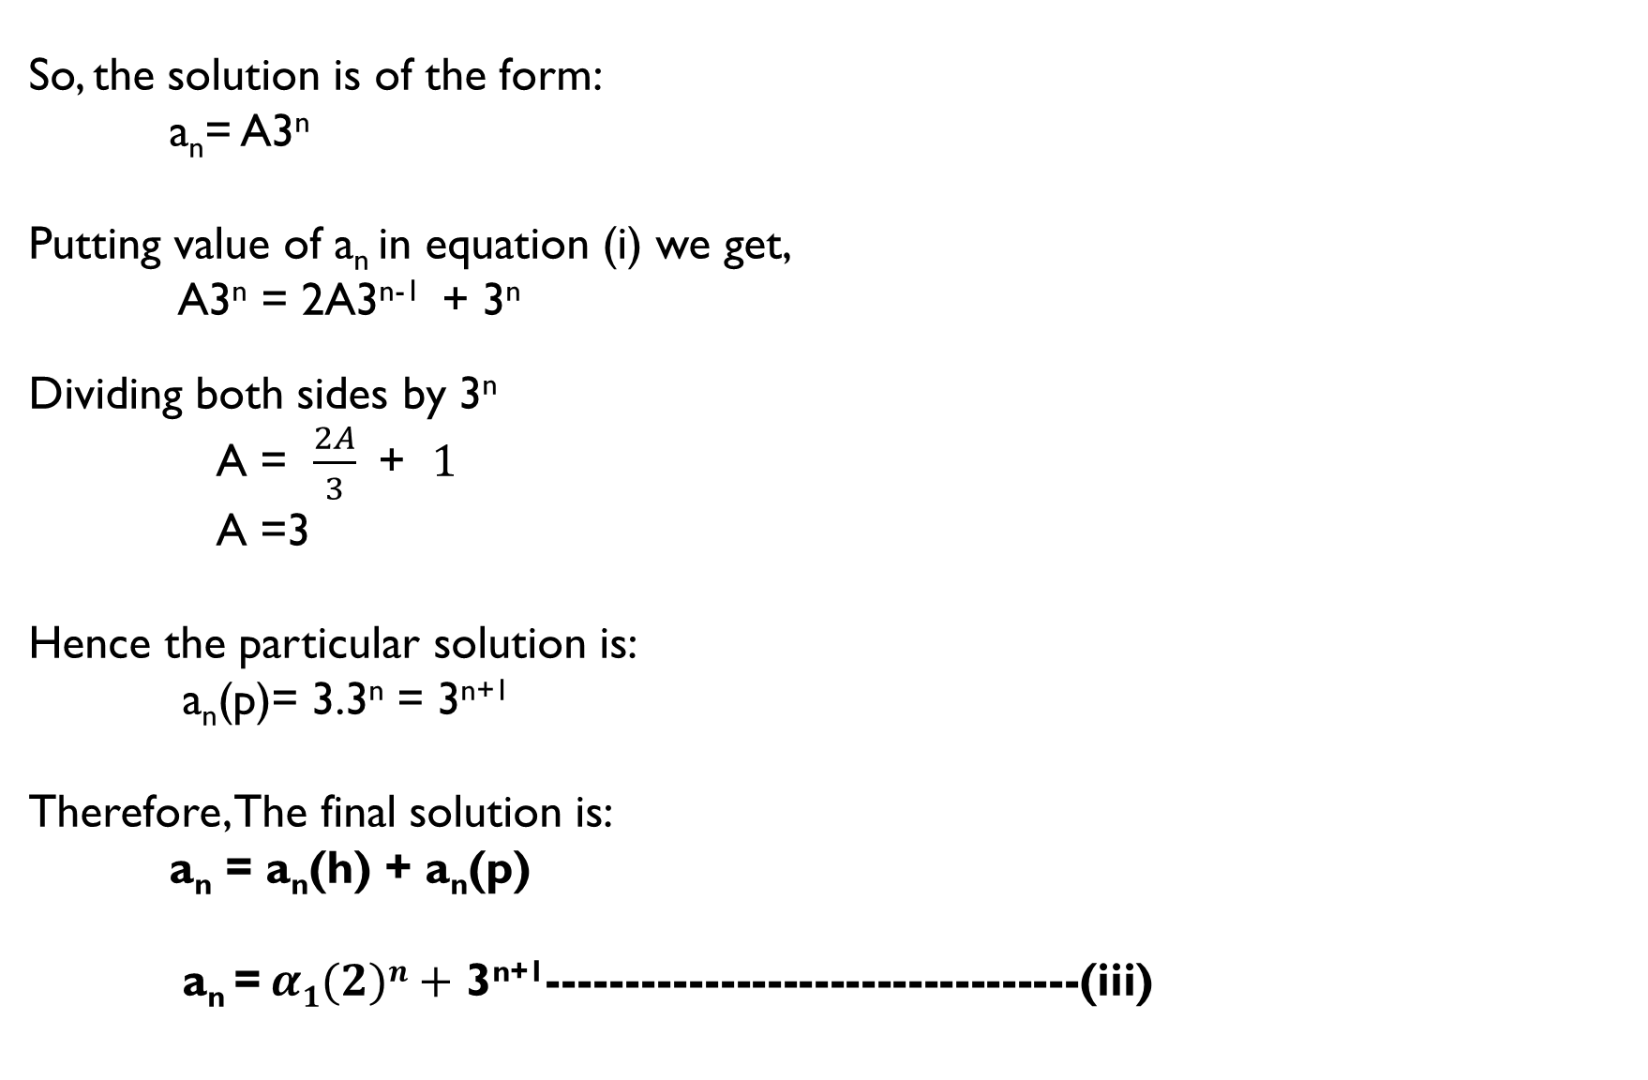
So, the solution is of the form:
a_{n}= A3^{n}
Putting value of a_{n} in equation (i) we get,
A3^{n} = 2A3^{n-1} + 3^{n}
Dividing both sides by 3^{n}
A = $\frac{2A}{3}$ + $1$
A =3
Hence the particular solution is:
a_{n}(p)= 3.3^{n} = 3^{n+1}
Therefore, The final solution is:
a_{n} = a_{n}(h) + a_{n}(p)
a_{n} = $α1(2)n+$ 3^{n+1}----------------------------------(iii)

Slide 15
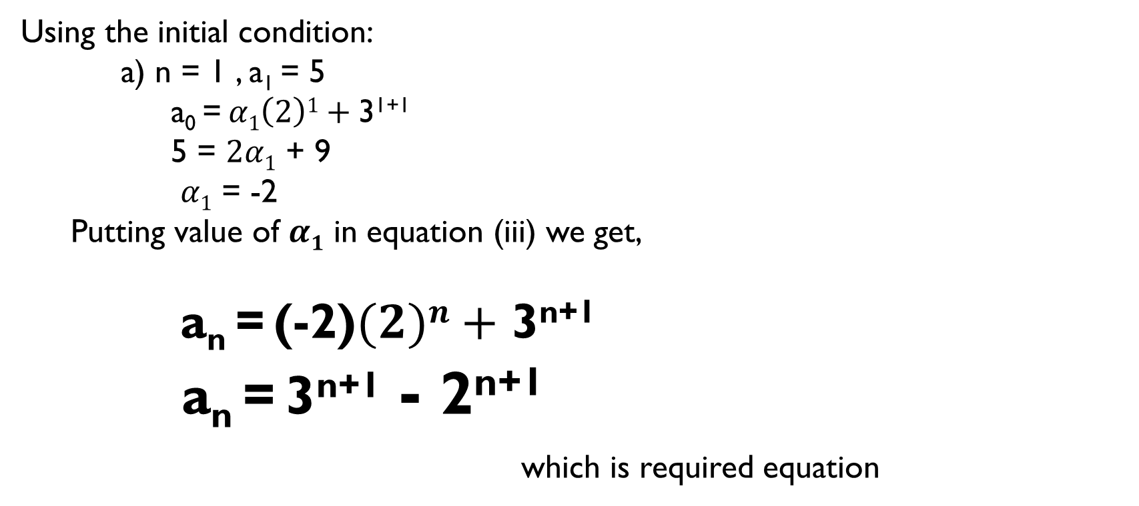
Using the initial condition:
a) n = 1 , a₁ = 5
a₀ = $α1\left(2\right)1+$3¹⁺¹
5 = $2α1$ + 9
$α1$ = -2
Putting value of $α1$ in equation (iii) we get,
a_{n} = (-2)$(2)n+$ 3^{n+1}
a_{n} = 3^{n+1} - 2^{n+1}
which is required equation

Slide 16
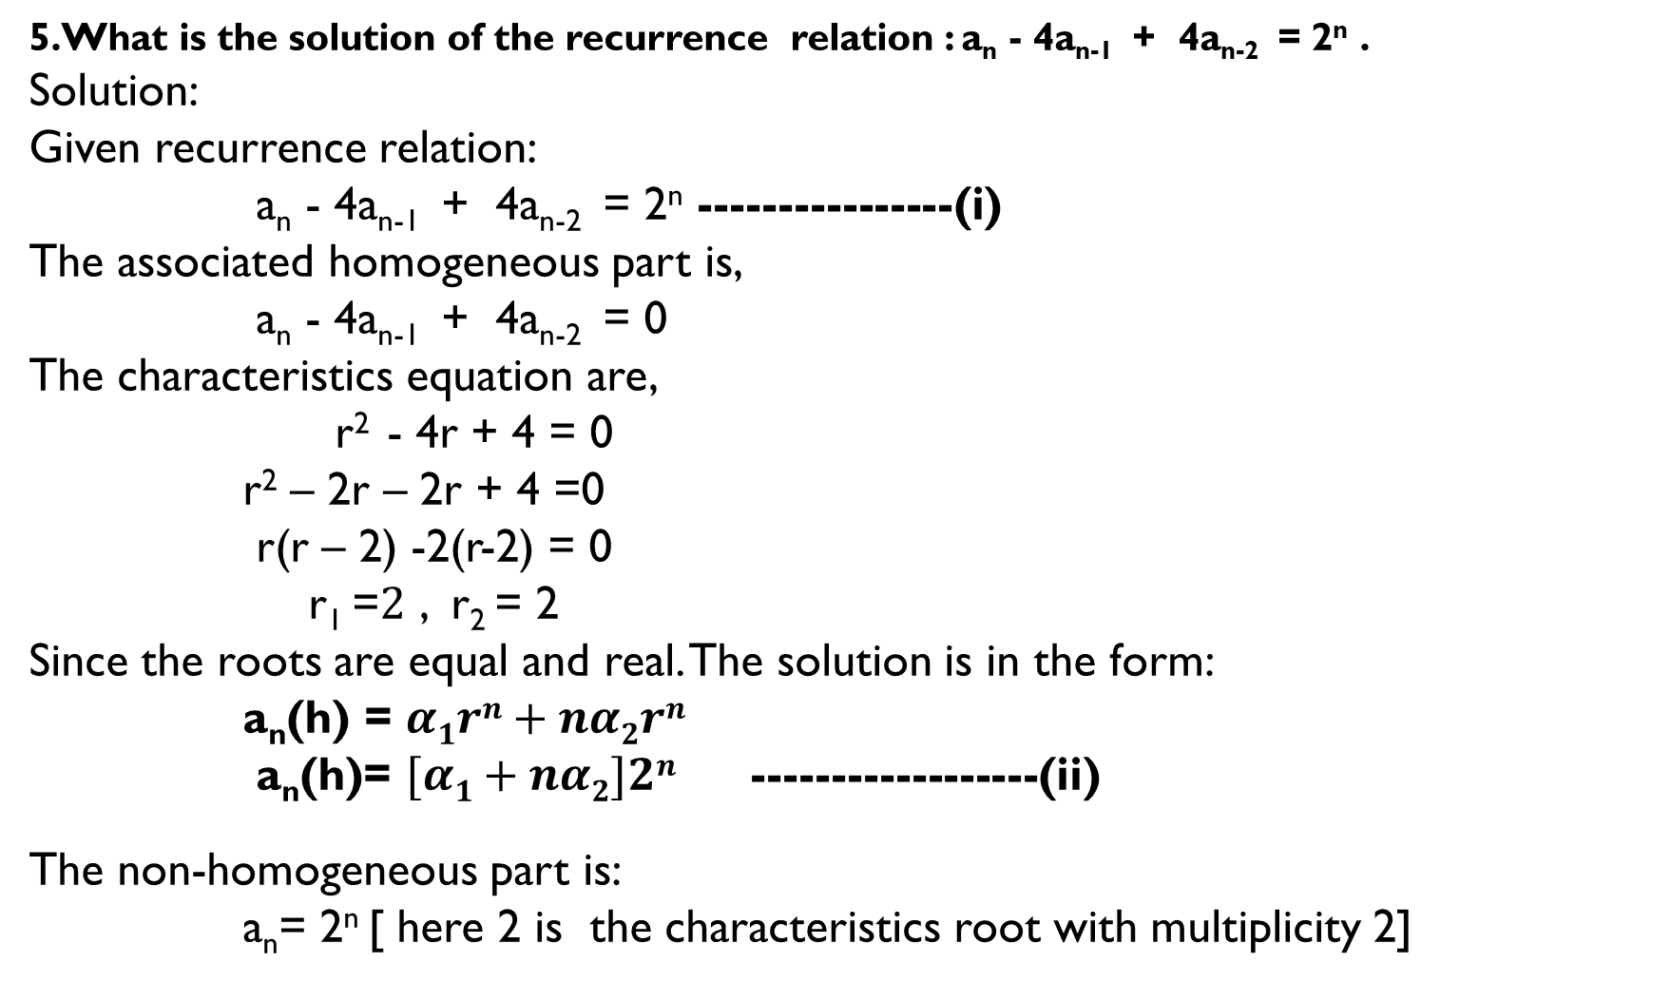
5.What is the solution of the recurrence relation : a_{n} - 4a_{n-1} + 4a_{n-2} = 2^{n} .
Solution:
Given recurrence relation:
a_{n} - 4a_{n-1} + 4a_{n-2} = 2^{n} ----------------(i)
The associated homogeneous part is,
a_{n} - 4a_{n-1} + 4a_{n-2} = 0
The characteristics equation are,
r² - 4r + 4 = 0
r² – 2r – 2r + 4 =0
r(r – 2) -2(r-2) = 0
r₁ =$2$ , r₂ = 2
Since the roots are equal and real. The solution is in the form:
a_{n}(h) = $α1rn+nα2rn$
a_{n}(h)= $[α1+nα2]2n$ ------------------(ii)
The non-homogeneous part is:
a_{n}= 2^{n} [ here 2 is the characteristics root with multiplicity 2]

Slide 17
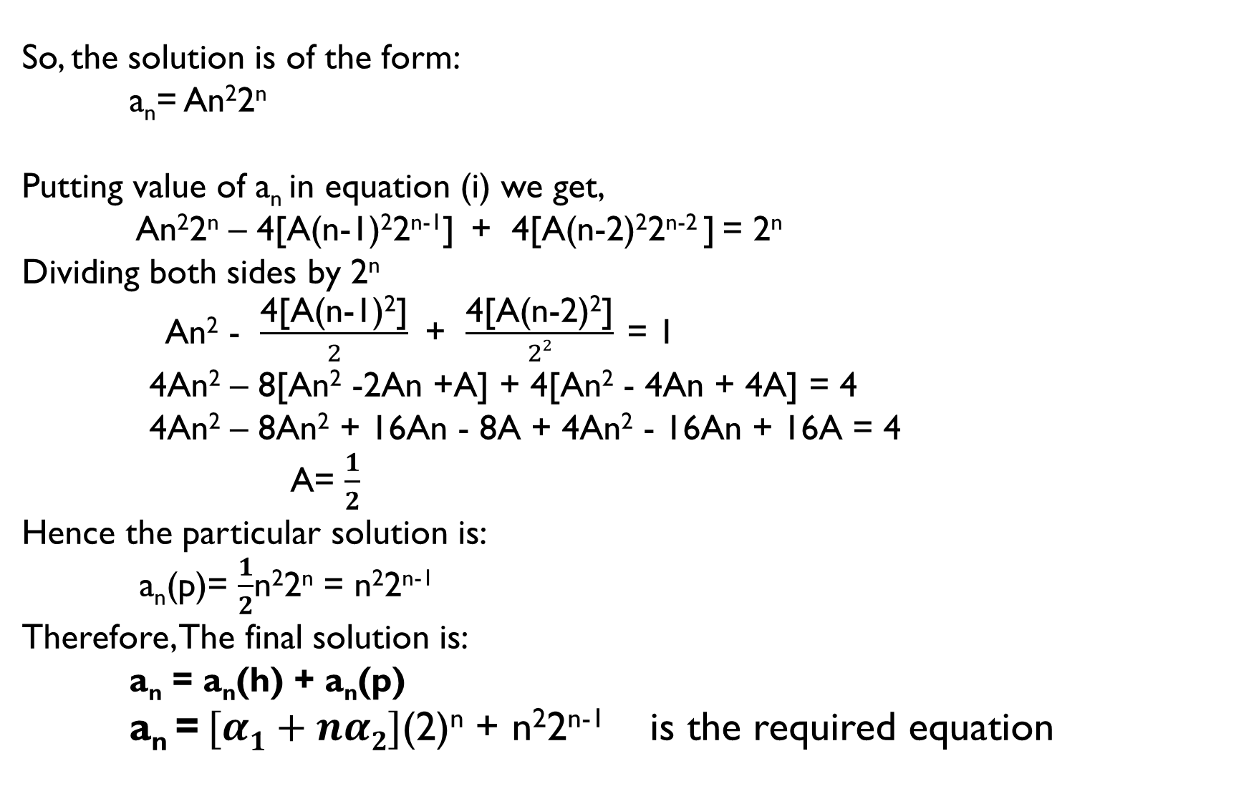
So, the solution is of the form:
a_{n}= An²2^{n}
Putting value of a_{n} in equation (i) we get,
An²2^{n} – 4[A(n-1)²2^{n-1}] + 4[A(n-2)²2^{n-2} ] = 2^{n}
Dividing both sides by 2^{n}
An² - $\frac{\text{4[}\text{A}\text{(}\text{n}\text{−1)2]}}{2}$ + $\frac{\text{4[}\text{A}\text{(}\text{n}\text{−2)2]}}{22}$ = 1
4An² – 8[An² -2An +A] + 4[An² - 4An + 4A] = 4
4An² – 8An² + 16An - 8A + 4An² - 16An + 16A = 4
A= $\frac{1}{2}$
Hence the particular solution is:
a_{n}(p)= $\frac{1}{2}$n²2^{n} = n²2^{n-1}
Therefore, The final solution is:
a_{n} = a_{n}(h) + a_{n}(p)
a_{n} = $[α1+nα2]$(2)^{n} + n²2^{n-1} is the required equation

Slide 18
Method to find Particular solution:
When f(n) is a polynomial in n
(i)If f(n) is first degree polynomial in n
a_{n}(p) = A₀ + A₁n
(ii) If f(n) is Second degree polynomial in n
a_{n}(p) = A₀ + A₁n + n²A₂
(iii) If f(n) is Third degree polynomial in n
a_{n}(p) = A₀ + A₁n + n²A₂ + n³A₃

Slide 19
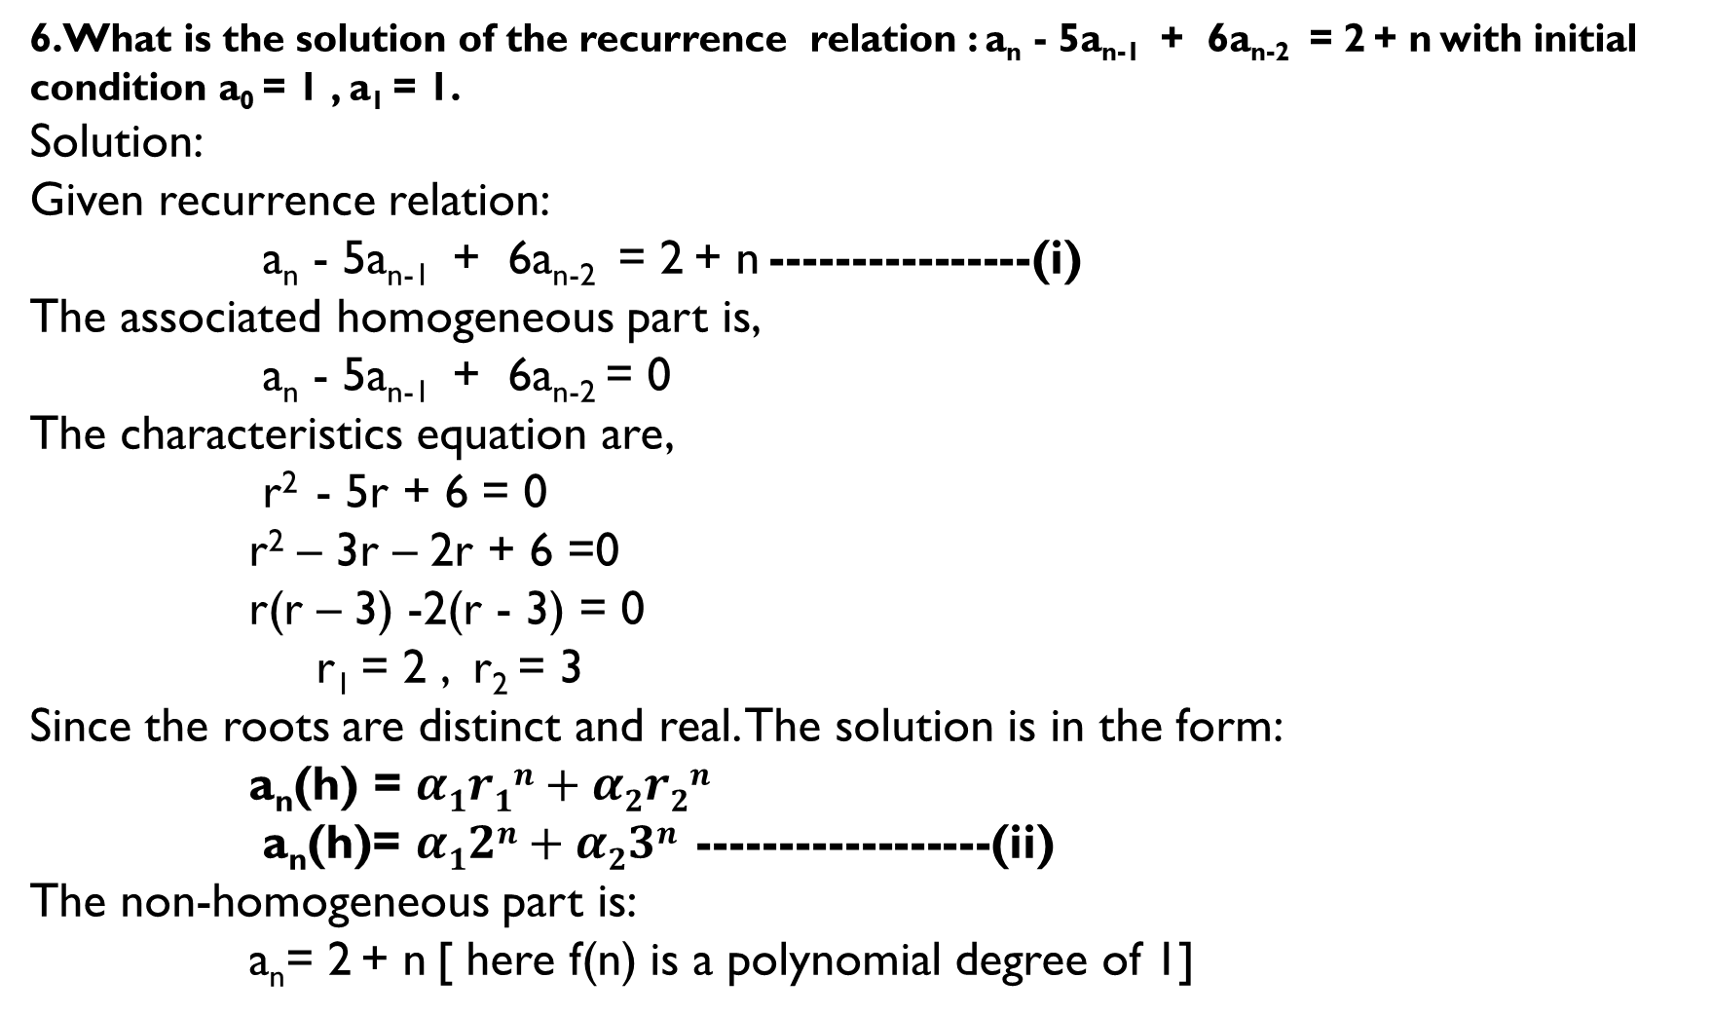
6.What is the solution of the recurrence relation : a_{n} - 5a_{n-1} + 6a_{n-2} = 2 + n with initial condition a₀ = 1 , a₁ = 1.
Solution:
Given recurrence relation:
a_{n} - 5a_{n-1} + 6a_{n-2} = 2 + n ----------------(i)
The associated homogeneous part is,
a_{n} - 5a_{n-1} + 6a_{n-2} = 0
The characteristics equation are,
r² - 5r + 6 = 0
r² – 3r – 2r + 6 =0
r(r – 3) -2(r - 3) = 0
r₁ = 2 , r₂ = 3
Since the roots are distinct and real. The solution is in the form:
a_{n}(h) = $α1r1n+α2r2n$
a_{n}(h)= $α12n+α23n$ ------------------(ii)
The non-homogeneous part is:
a_{n}= 2 + n [ here f(n) is a polynomial degree of 1]

Slide 20
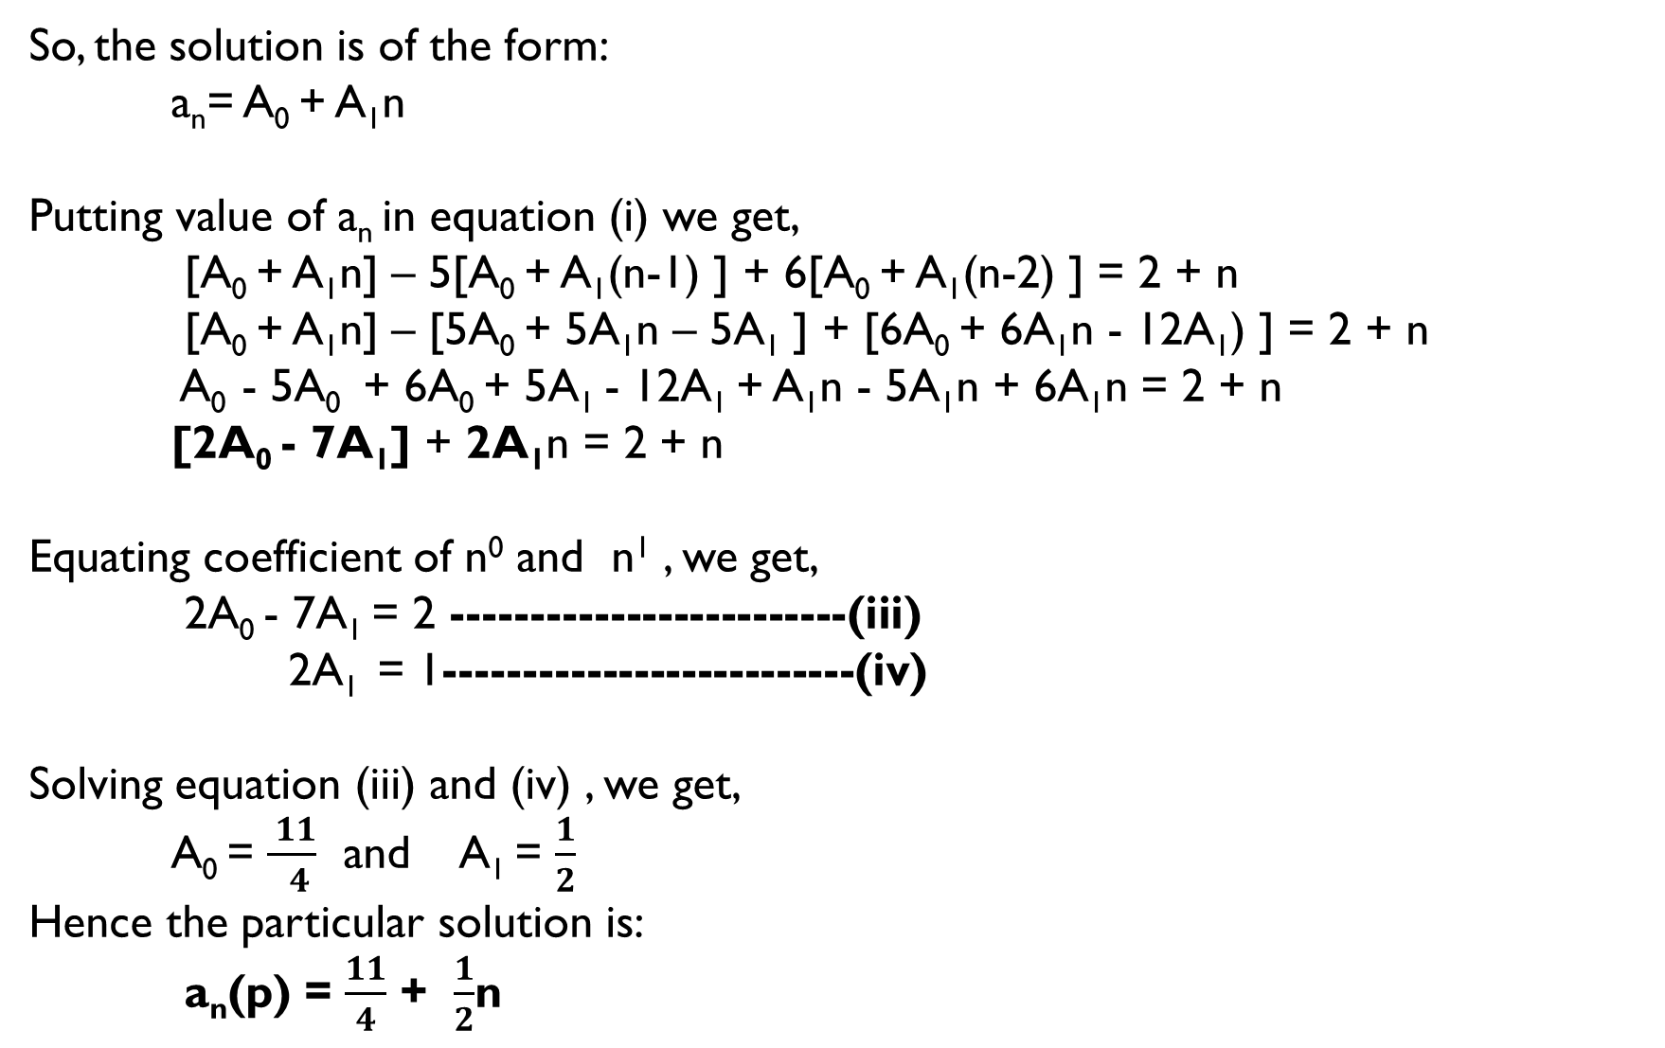
So, the solution is of the form:
a_{n}= A₀ + A₁n
Putting value of a_{n} in equation (i) we get,
[A₀ + A₁n] – 5[A₀ + A₁(n-1) ] + 6[A₀ + A₁(n-2) ] = 2 + n
[A₀ + A₁n] – [5A₀ + 5A₁n – 5A₁ ] + [6A₀ + 6A₁n - 12A₁) ] = 2 + n
A₀ - 5A₀ + 6A₀ + 5A₁ - 12A₁ + A₁n - 5A₁n + 6A₁n = 2 + n
[2A₀ - 7A₁] + 2A₁n = 2 + n
Equating coefficient of n⁰ and n¹ , we get,
2A₀ - 7A₁ = 2 -------------------------(iii)
2A₁ = 1--------------------------(iv)
Solving equation (iii) and (iv) , we get,
A₀ = $\frac{ 11}{ 4}$ and A₁ = $\frac{1}{2}$
Hence the particular solution is:
a_{n}(p) = $\frac{11}{4}$ + $\frac{1}{2}$n

Slide 21
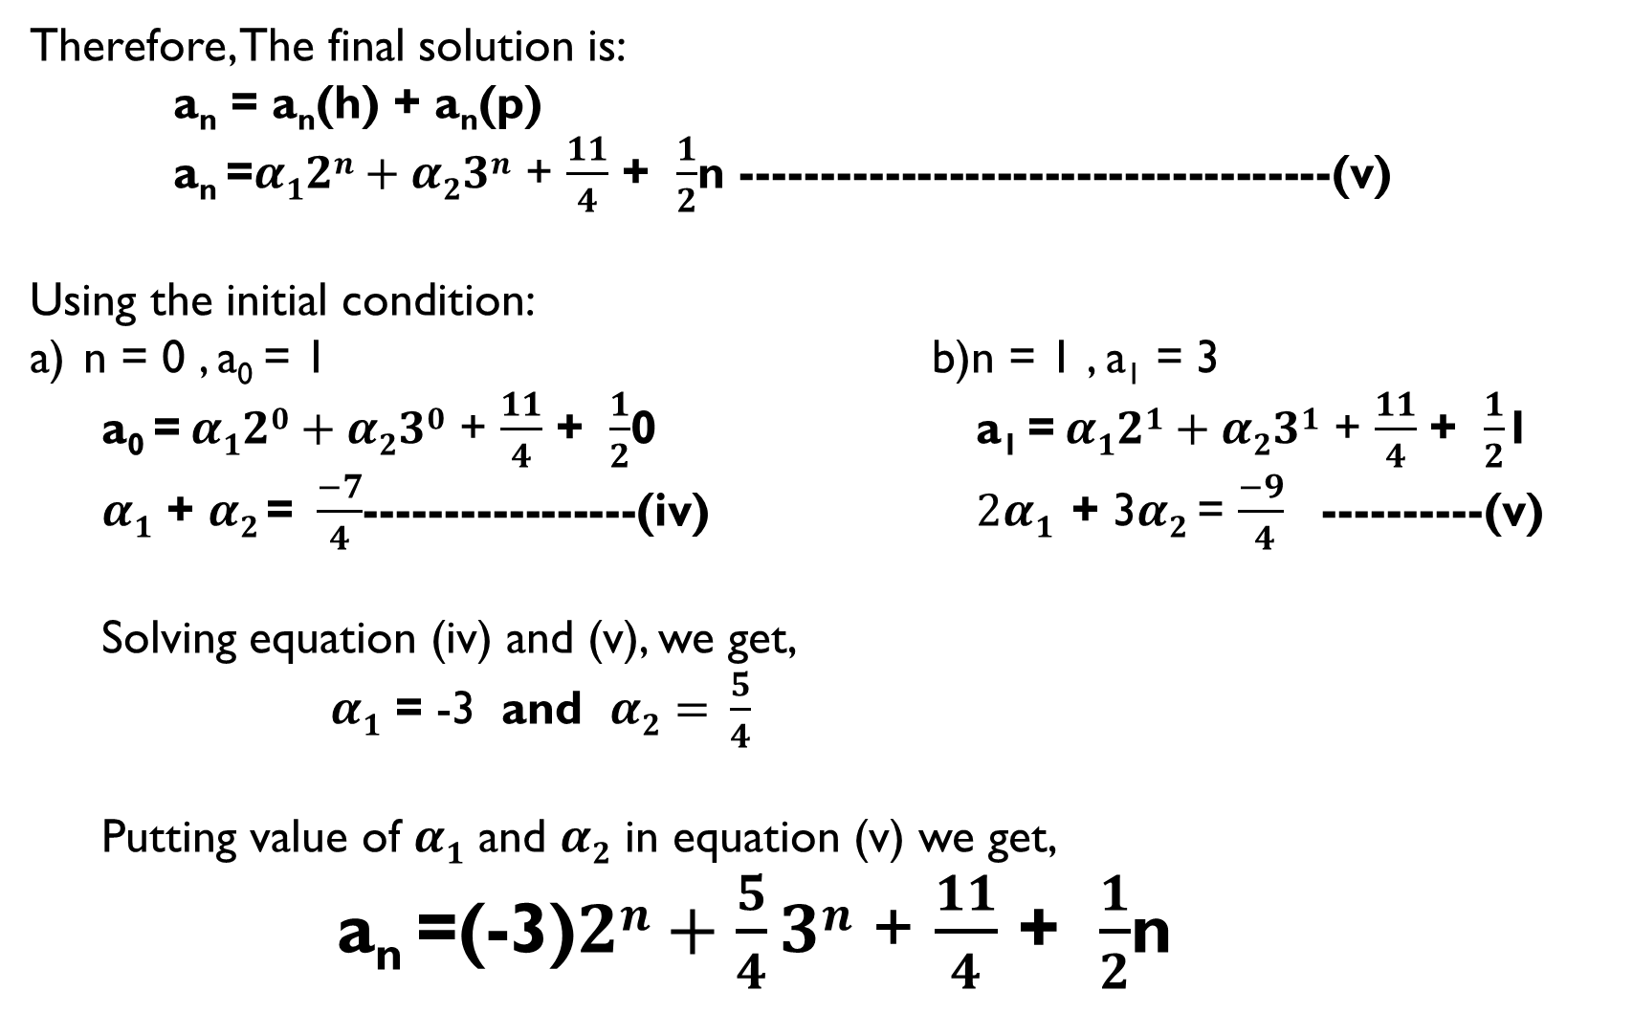
Therefore, The final solution is:
a_{n} = a_{n}(h) + a_{n}(p)
a_{n} =$α12n+α23n$ + $\frac{11}{4}$ + $\frac{1}{2}$n -------------------------------------(v)
Using the initial condition:
n = 0 , a₀ = 1 b)n = 1 , a₁ = 3
a₀ = $α120+α230$ + $\frac{11}{4}$ + $\frac{1}{2}$0 a₁ = $α121+α231$ + $\frac{11}{4}$ + $\frac{1}{2}$1
$α1$ + $α2$= $\frac{−7}{4}$-----------------(iv) $2α1$ + 3$α2$ = $\frac{−9}{ 4}$ ----------(v)
Solving equation (iv) and (v), we get,
$α1$ = -3 and $α2= \frac{5}{4}$
Putting value of $α1$ and $α2$ in equation (v) we get,
a_{n} =(-3)$2n+\frac{5}{4}3n$ + $\frac{11}{4}$ + $\frac{1}{2}$n

Slide 22
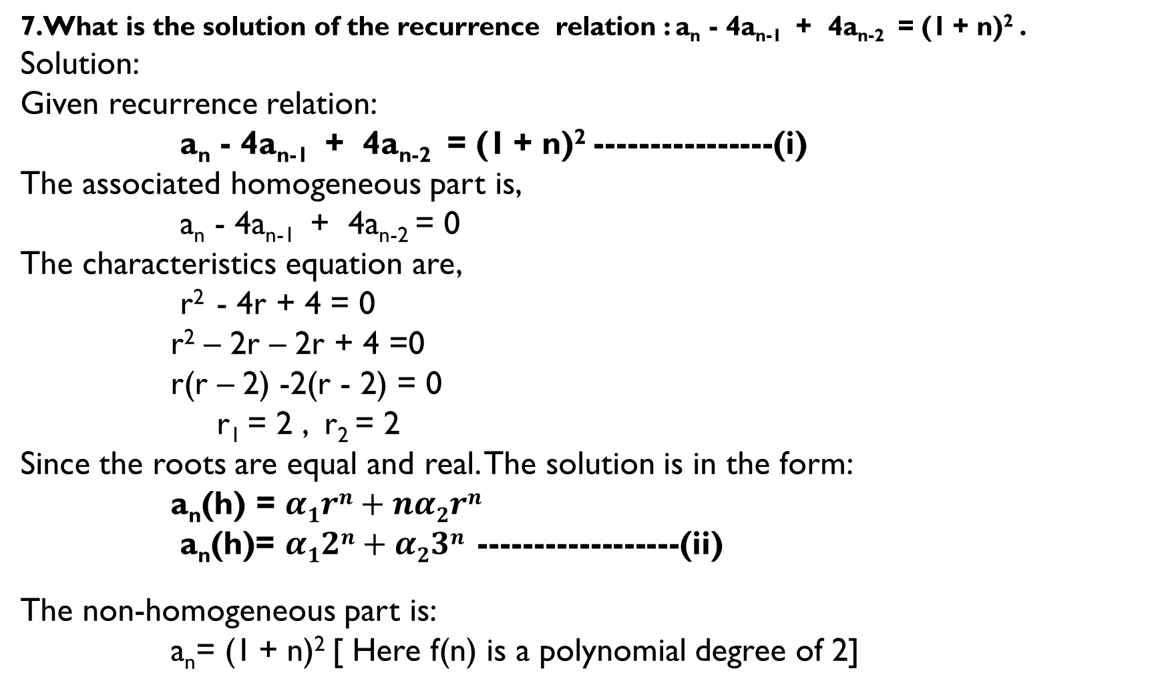
7.What is the solution of the recurrence relation : a_{n} - 4a_{n-1} + 4a_{n-2} = (1 + n)² .
Solution:
Given recurrence relation:
a_{n} - 4a_{n-1} + 4a_{n-2} = (1 + n)² ----------------(i)
The associated homogeneous part is,
a_{n} - 4a_{n-1} + 4a_{n-2} = 0
The characteristics equation are,
r² - 4r + 4 = 0
r² – 2r – 2r + 4 =0
r(r – 2) -2(r - 2) = 0
r₁ = 2 , r₂ = 2
Since the roots are equal and real. The solution is in the form:
a_{n}(h) = $α1rn+nα2rn$
a_{n}(h)= $α12n+α23n$ ------------------(ii)
The non-homogeneous part is:
a_{n}= (1 + n)² [ Here f(n) is a polynomial degree of 2]

Slide 23
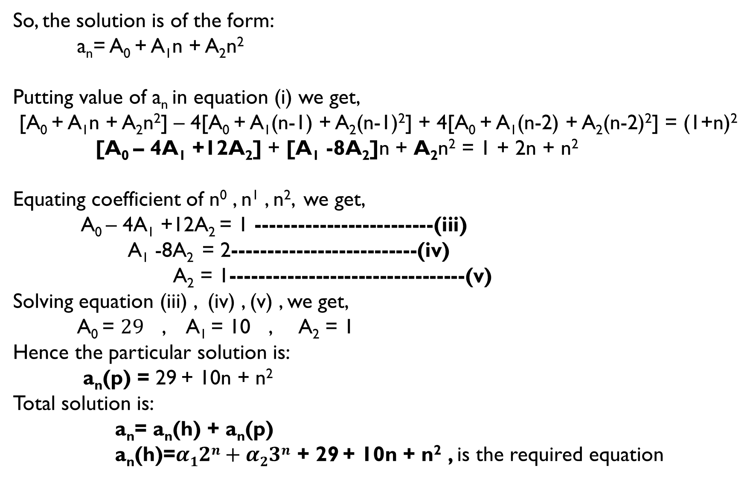
So, the solution is of the form:
a_{n}= A₀ + A₁n + A₂n²
Putting value of a_{n} in equation (i) we get,
[A₀ + A₁n + A₂n²] – 4[A₀ + A₁(n-1) + A₂(n-1)²] + 4[A₀ + A₁(n-2) + A₂(n-2)²] = (1+n)²
[A₀ – 4A₁ +12A₂] + [A₁ -8A₂]n + A₂n² = 1 + 2n + n²
Equating coefficient of n⁰ , n¹ , n², we get,
A₀ – 4A₁ +12A₂ = 1 -------------------------(iii)
A₁ -8A₂ = 2--------------------------(iv)
A₂ = 1---------------------------------(v)
Solving equation (iii) , (iv) , (v) , we get,
A₀ = $29$ , A₁ = 10 , A₂ = 1
Hence the particular solution is:
a_{n}(p) = 29 + 10n + n²
Total solution is:
a_{n}= a_{n}(h) + a_{n}(p)
a_{n}(h)=$α12n+α23n$ + 29 + 10n + n² , is the required equation

Slide 24
Method to find Particular solution:
3) When f(n) is a constant i.e f(n) = k
We can write f(n) = k.(1)^{n}
(i)If 1 is not the characteristic root then,
a_{n}(p) = A₀
(ii) If 1 is the characteristic root with multiplicity m then,
a_{n}(p) = A₀n^{m}

Slide 25
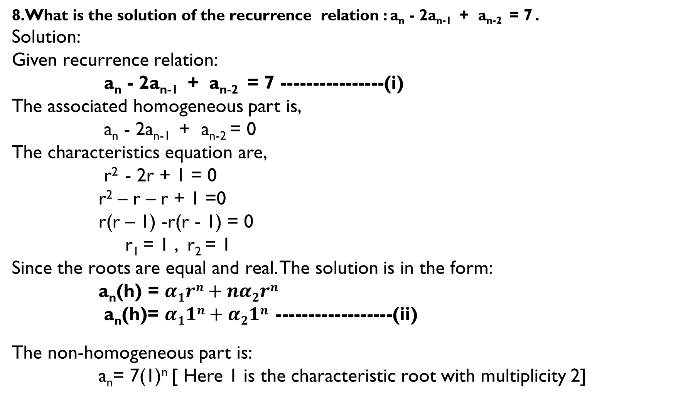
8.What is the solution of the recurrence relation : a_{n} - 2a_{n-1} + a_{n-2} = 7 .
Solution:
Given recurrence relation:
a_{n} - 2a_{n-1} + a_{n-2} = 7 ----------------(i)
The associated homogeneous part is,
a_{n} - 2a_{n-1} + a_{n-2} = 0
The characteristics equation are,
r² - 2r + 1 = 0
r² – r – r + 1 =0
r(r – 1) -r(r - 1) = 0
r₁ = 1 , r₂ = 1
Since the roots are equal and real. The solution is in the form:
a_{n}(h) = $α1rn+nα2rn$
a_{n}(h)= $α11n+α21n$ ------------------(ii)
The non-homogeneous part is:
a_{n}= 7(1)^{n} [ Here 1 is the characteristic root with multiplicity 2]

Slide 26
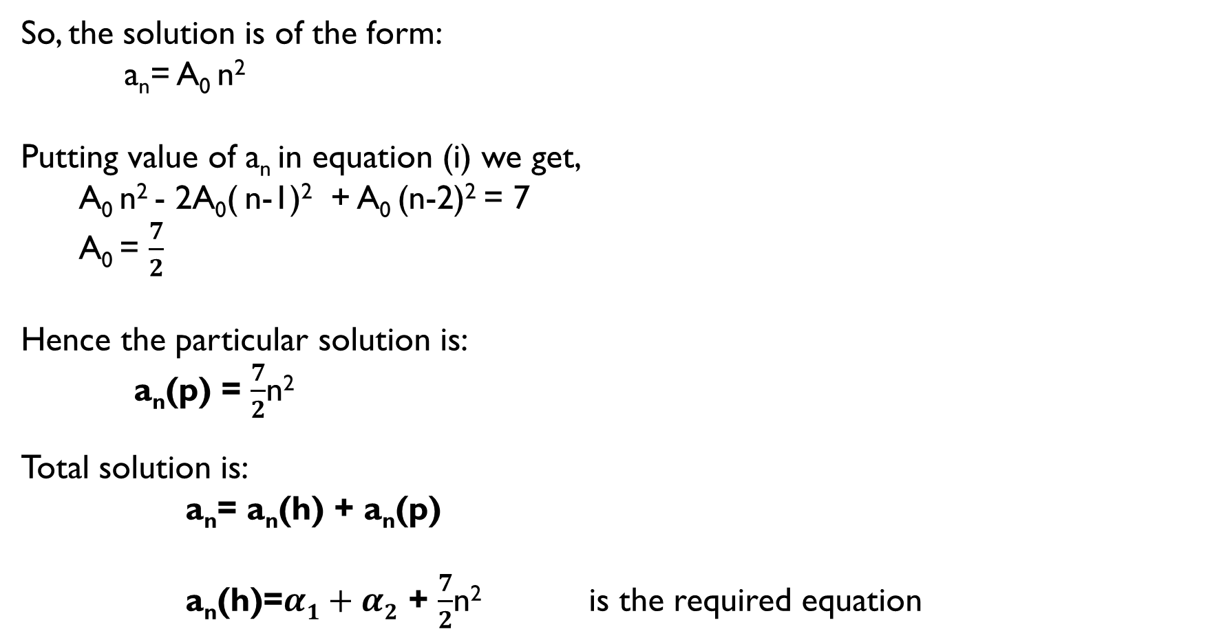
So, the solution is of the form:
a_{n}= A₀ n²
Putting value of a_{n} in equation (i) we get,
A₀ n² - 2A₀( n-1)² + A₀ (n-2)² = 7
A₀ = $\frac{7}{2}$
Hence the particular solution is:
a_{n}(p) = $\frac{7}{2}$n²
Total solution is:
a_{n}= a_{n}(h) + a_{n}(p)
a_{n}(h)=$α1+α2$ + $\frac{7}{2}$n² is the required equation

Slide 27
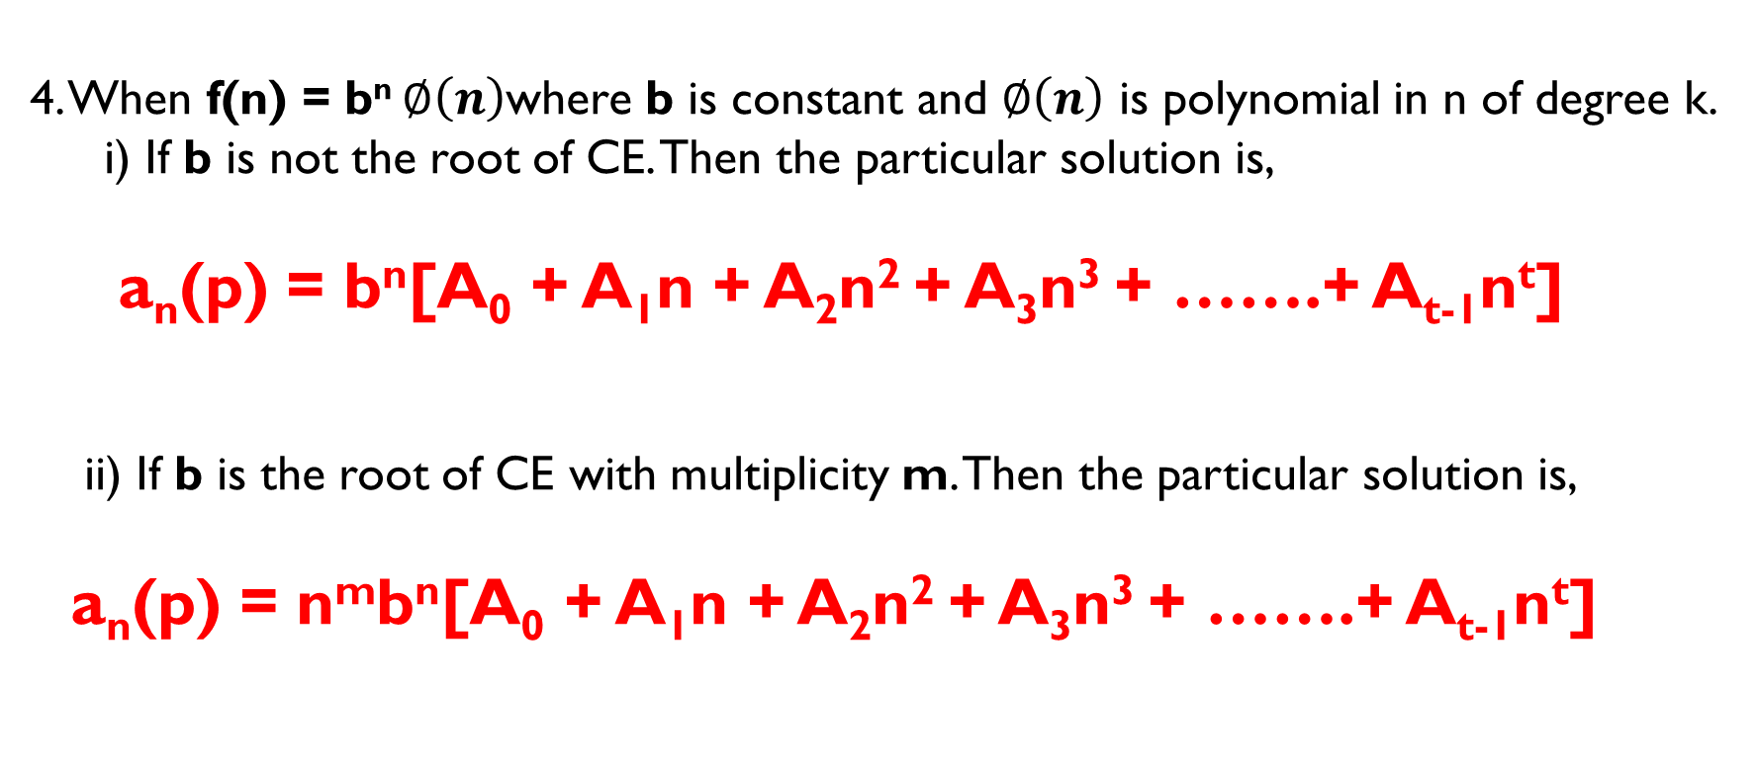
Method to find Particular solution:
4. When f(n) = b^{n} $∅\left(n\right)$where b is constant and $∅\left(n\right)$ is polynomial in n of degree k.
i) If b is not the root of CE. Then the particular solution is,
a_{n}(p) = b^{n}[A₀ + A₁n + A₂n² + A₃n³ + …….+ A_{t-1}n^{t}]
ii) If b is the root of CE with multiplicity m. Then the particular solution is,
a_{n}(p) = n^{m}b^{n}[A₀ + A₁n + A₂n² + A₃n³ + …….+ A_{t-1}n^{t}]

Slide 28
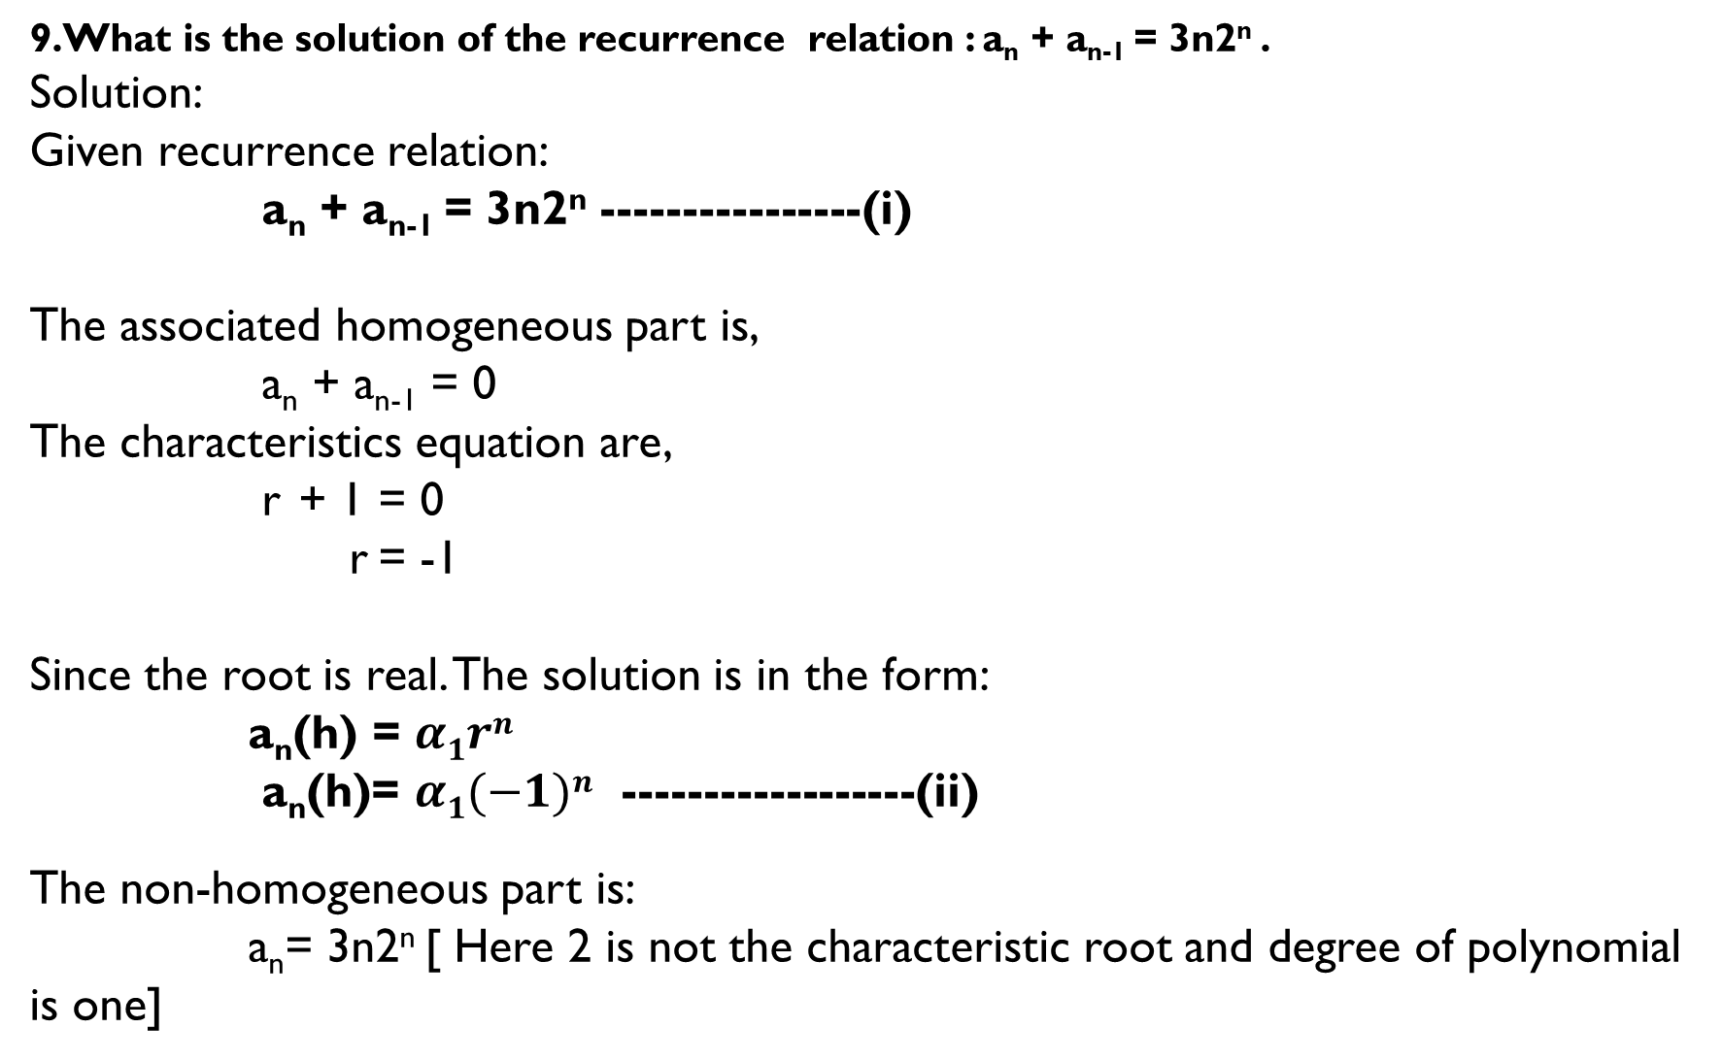
9.What is the solution of the recurrence relation : a_{n} + a_{n-1} = 3n2^{n} .
Solution:
Given recurrence relation:
a_{n} + a_{n-1} = 3n2^{n} ----------------(i)
The associated homogeneous part is,
a_{n} + a_{n-1} = 0
The characteristics equation are,
r + 1 = 0
r = -1
Since the root is real. The solution is in the form:
a_{n}(h) = $α1rn$
a_{n}(h)= $α1(−1)n$ ------------------(ii)
The non-homogeneous part is:
a_{n}= 3n2^{n} [ Here 2 is not the characteristic root and degree of polynomial is one]

Slide 29
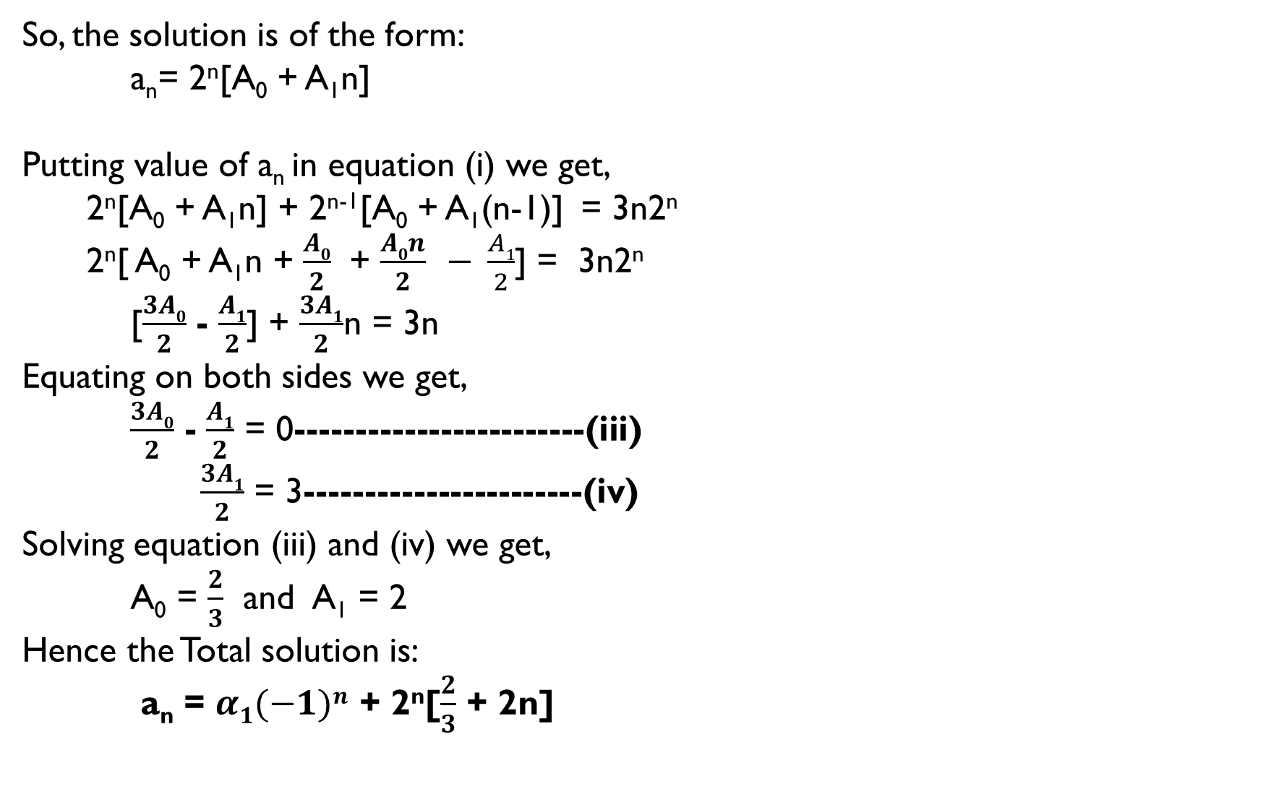
So, the solution is of the form:
a_{n}= 2^{n}[A₀ + A₁n]
Putting value of a_{n} in equation (i) we get,
2^{n}[A₀ + A₁n] + 2^{n-1}[A₀ + A₁(n-1)] = 3n2^{n}
2^{n}[ A₀ + A₁n + $\frac{A0}{2}$ + $\frac{A0n}{2}$ $− \frac{A1}{2}$] = 3n2^{n}
[$\frac{3A0}{2}$ - $\frac{A1}{2}$] + $\frac{3A1}{2}$n = 3n
Equating on both sides we get,
$\frac{3A0}{2}$ - $\frac{A1}{2}$ = 0------------------------(iii)
$\frac{3A1}{2}$ = 3-----------------------(iv)
Solving equation (iii) and (iv) we get,
A₀ = $\frac{2}{3}$ and A₁ = 2
Hence the Total solution is:
a_{n} = $α1(−1)n$ + 2^{n}[$\frac{2}{3}$ + 2n]

Slide 30
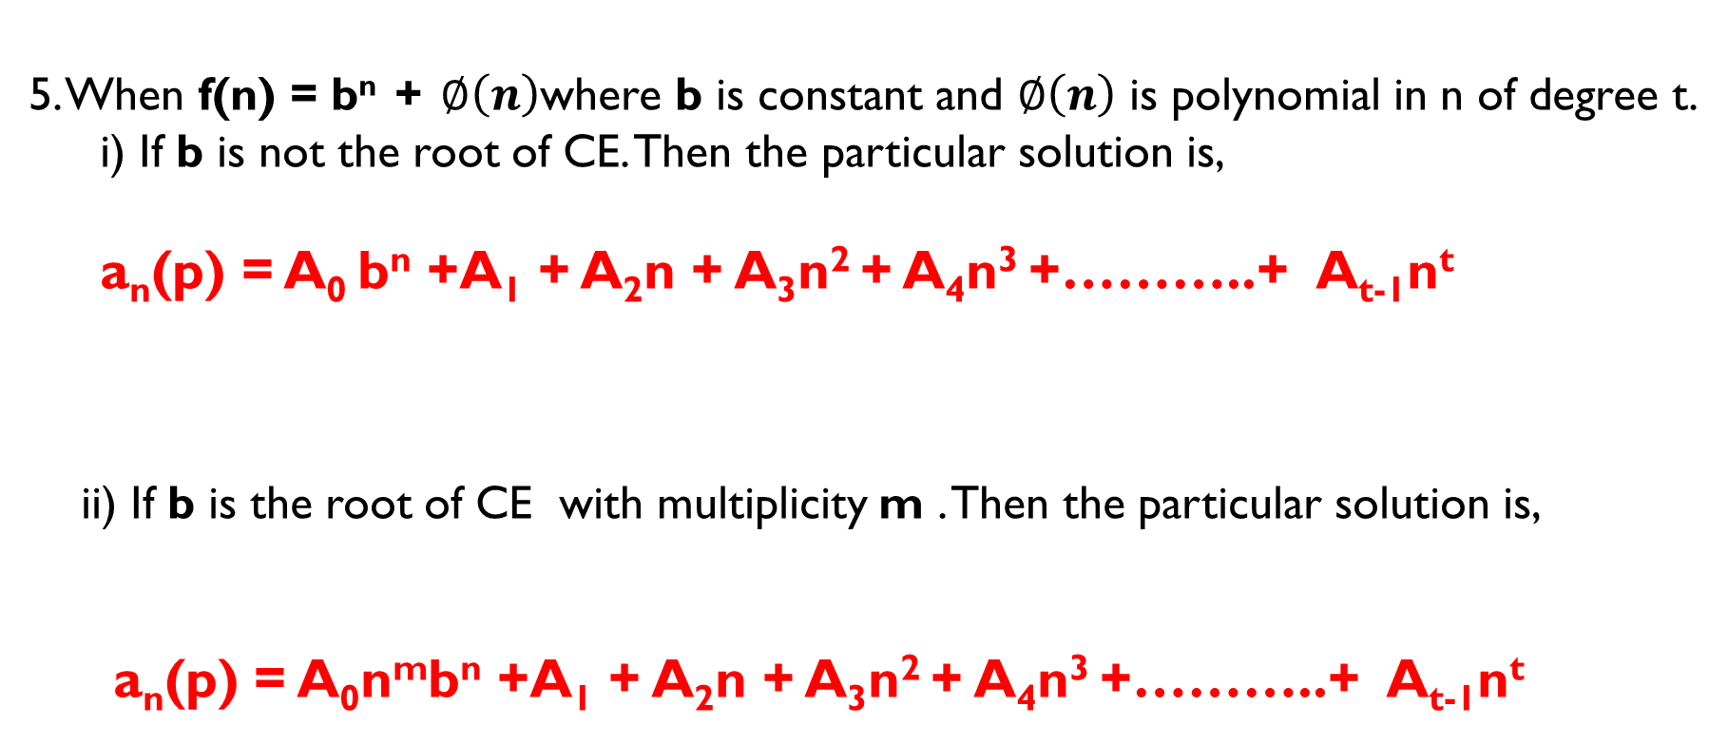
Method to find Particular solution:
5. When f(n) = b^{n} + $∅\left(n\right)$where b is constant and $∅\left(n\right)$ is polynomial in n of degree t.
i) If b is not the root of CE. Then the particular solution is,
a_{n}(p) = A₀ b^{n} +A₁ + A₂n + A₃n² + A₄n³ +………..+ A_{t-1}n^{t}
ii) If b is the root of CE with multiplicity m . Then the particular solution is,
a_{n}(p) = A₀n^{m}b^{n} +A₁ + A₂n + A₃n² + A₄n³ +………..+ A_{t-1}n^{t}

Slide 31
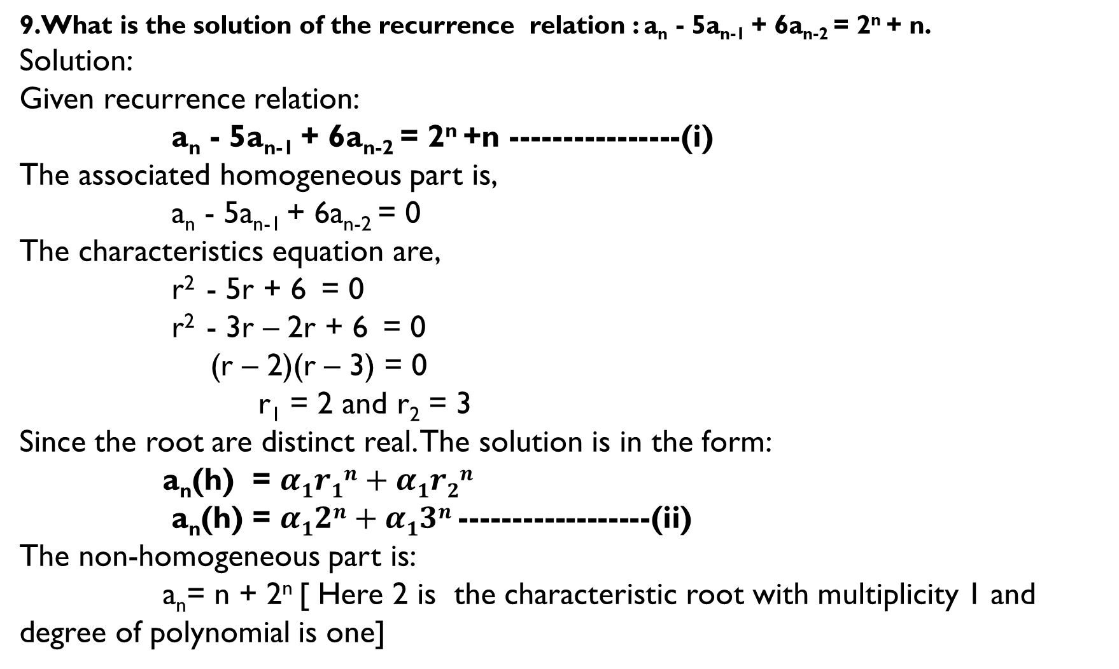
9.What is the solution of the recurrence relation : a_{n} - 5a_{n-1} + 6a_{n-2} = 2^{n} + n.
Solution:
Given recurrence relation:
a_{n} - 5a_{n-1} + 6a_{n-2} = 2^{n} +n ----------------(i)
The associated homogeneous part is,
a_{n} - 5a_{n-1} + 6a_{n-2} = 0
The characteristics equation are,
r² - 5r + 6 = 0
r² - 3r – 2r + 6 = 0
(r – 2)(r – 3) = 0
r₁ = 2 and r₂ = 3
Since the root are distinct real. The solution is in the form:
a_{n}(h) = $α1r1n+α1r2n$
a_{n}(h) = $α12n+α13n$ ------------------(ii)
The non-homogeneous part is:
a_{n}= n + 2^{n} [ Here 2 is the characteristic root with multiplicity 1 and degree of polynomial is one]

Slide 32
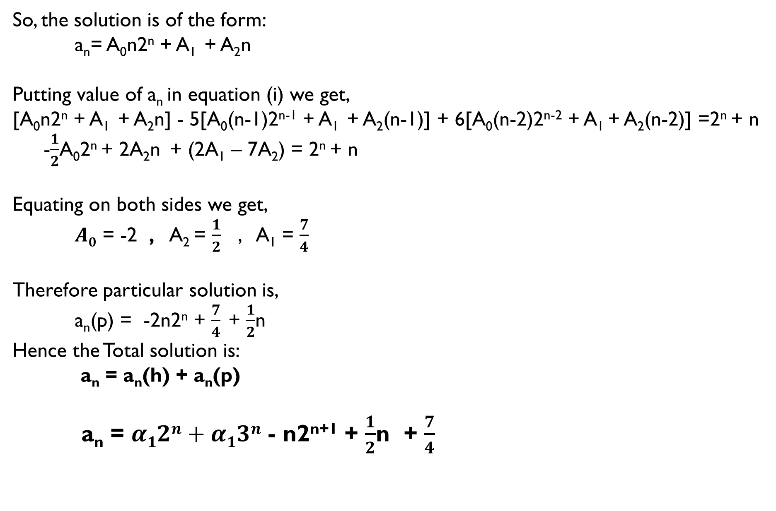
So, the solution is of the form:
a_{n}= A₀n2^{n} + A₁ + A₂n
Putting value of a_{n} in equation (i) we get,
[A₀n2^{n} + A₁ + A₂n] - 5[A₀(n-1)2^{n-1} + A₁ + A₂(n-1)] + 6[A₀(n-2)2^{n-2} + A₁ + A₂(n-2)] =2^{n} + n
-$\frac{1}{2}$A₀2^{n} + 2A₂n + (2A₁ – 7A₂) = 2^{n} + n
Equating on both sides we get,
$A0$ = -2 , A₂ = $\frac{1}{2}$ , A₁ = $\frac{7}{4}$
Therefore particular solution is,
a_{n}(p) = -2n2^{n} + $\frac{7}{4}$ + $\frac{1}{2}$n
Hence the Total solution is:
a_{n} = a_{n}(h) + a_{n}(p)
a_{n} = $α12n+α13n$ - n2^{n+1} + $\frac{1}{2}$n + $\frac{7}{4}$

